Slide 1
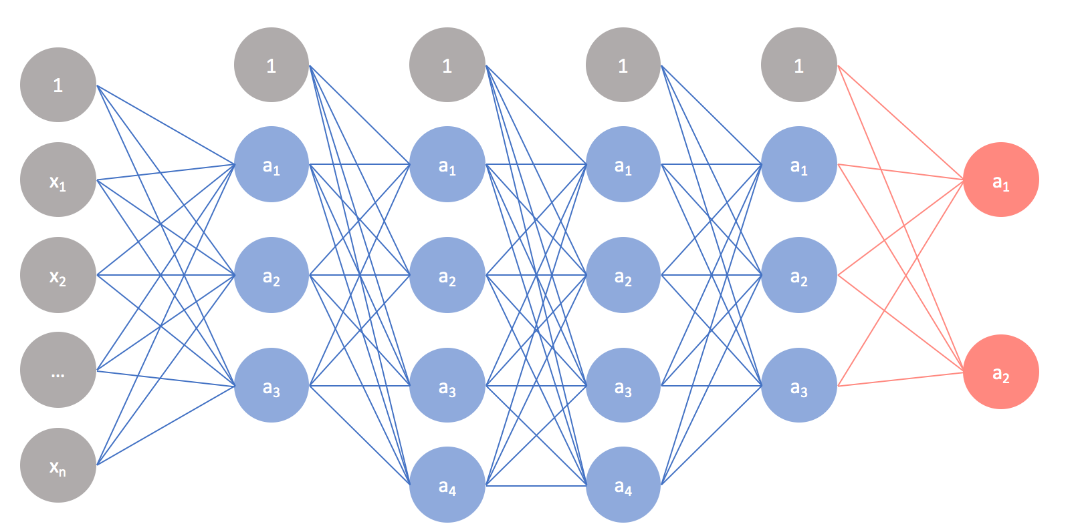
NN basics

Slide 2
References
http://cs231n.stanford.edu/index.html
http://www.cs.cornell.edu/courses/cs5670/2019sp/lectures/lectures.html
http://www.cs.cmu.edu/~16385/

Slide 3
- regularization NN
- conv NN
- max pooling
- batch norm
- transfer learning

Slide 4
A good fully connected example
https://playground.tensorflow.org/#activation=tanh&batchSize=10&dataset=spiral&regDataset=reg-plane&learningRate=0.03&regularizationRate=0&noise=0&networkShape=8,8,8&seed=0.68609&showTestData=false&discretize=false&percTrainData=50&x=true&y=true&xTimesY=true&xSquared=true&ySquared=true&cosX=false&sinX=true&cosY=false&sinY=true&collectStats=false&problem=classification&initZero=false&hideText=false

Slide 5
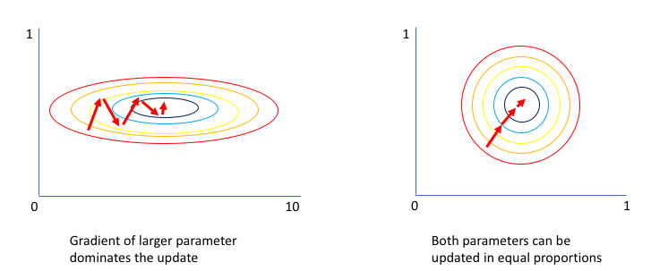
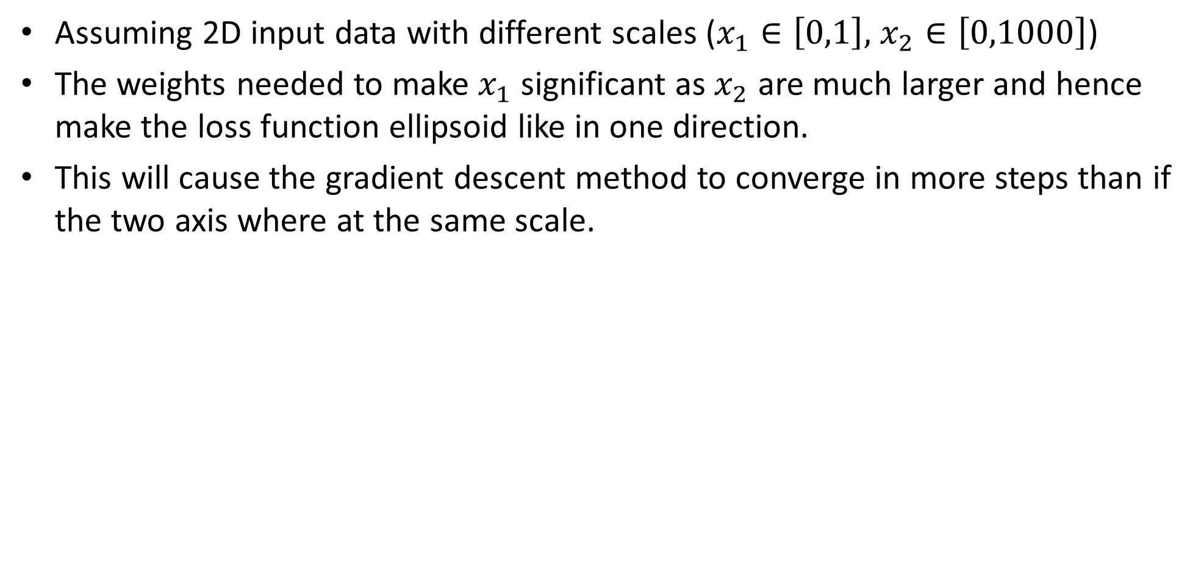
Data normalization
Assuming 2D input data with different scales ($x_{1}∈\left[0,1\right],$ $x_{2}∈\left[0,1000\right]$)
The weights needed to make $x_{1}$ significant as $x_{2}$ are much larger and hence make the loss function ellipsoid like in one direction.
This will cause the gradient descent method to converge in more steps than if the two axis where at the same scale.

Slide 6
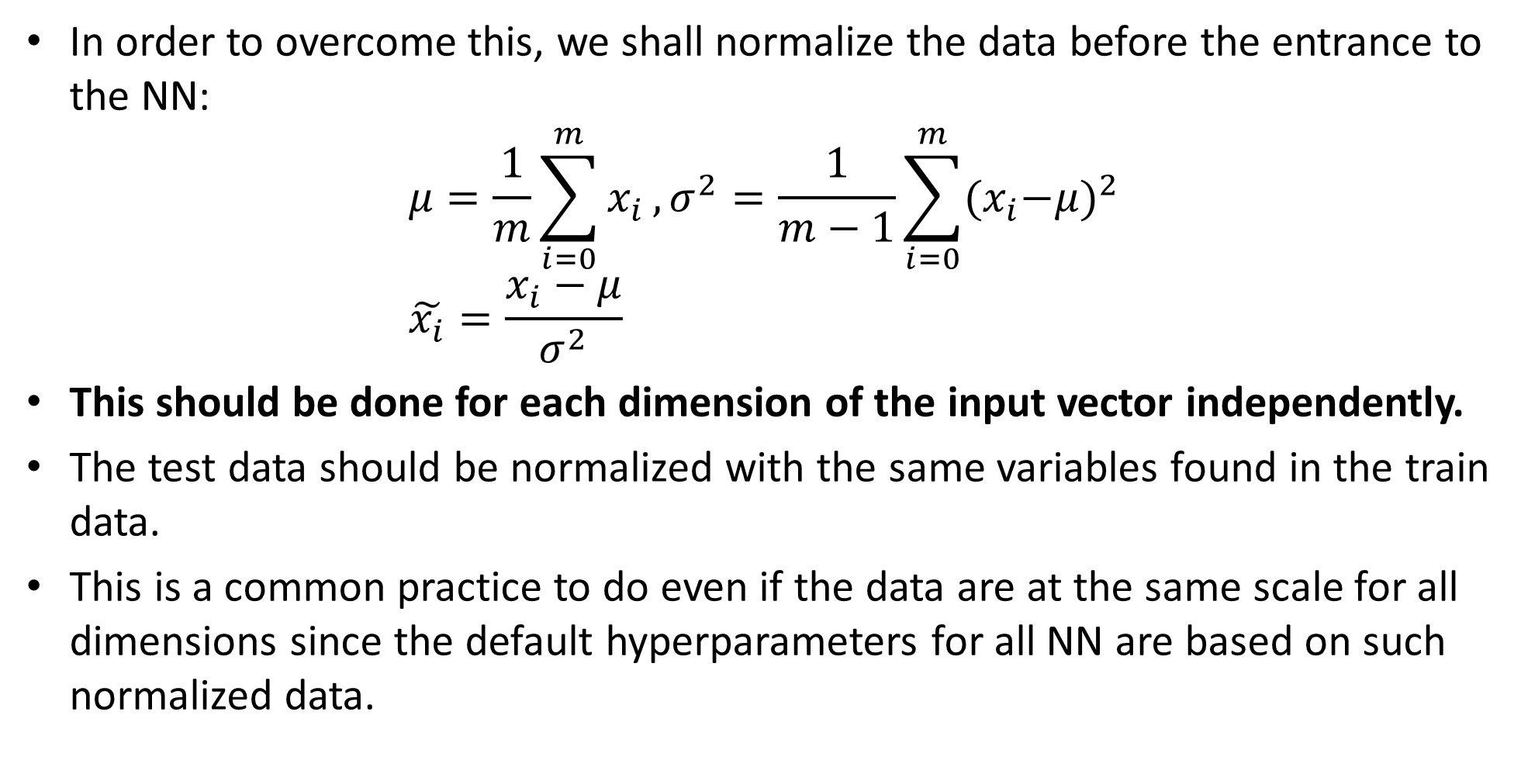
Data normalization
In order to overcome this, we shall normalize the data before the entrance to the NN:
$$μ=\frac{1}{m}\sum_{i=0}^{m}{x_{i}},σ^{2}=\frac{1}{m−1}\sum_{i=0}^{m}{{{(x}_{i}−μ)}^{2}} \\ \tilde{x_{i}}=\frac{x_{i}−μ}{σ^{2}}$$
This should be done for each dimension of the input vector independently.
The test data should be normalized with the same variables found in the train data.
This is a common practice to do even if the data are at the same scale for all dimensions since the default hyperparameters for all NN are based on such normalized data.

Slide 7
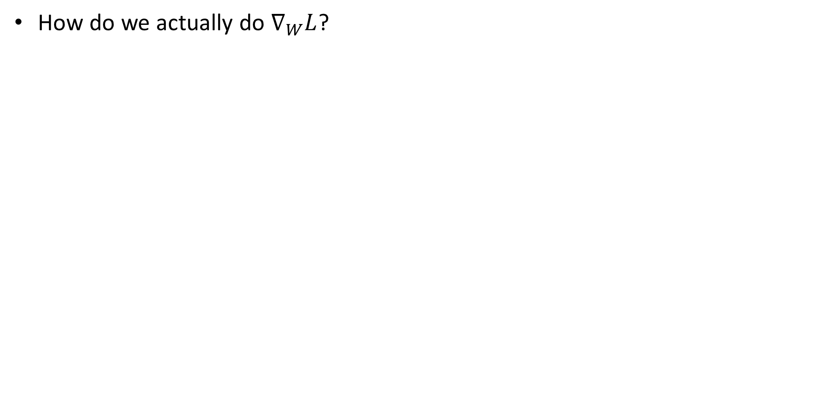
Loss derivation
How do we actually do $∇_{W}L$?

Slide 8
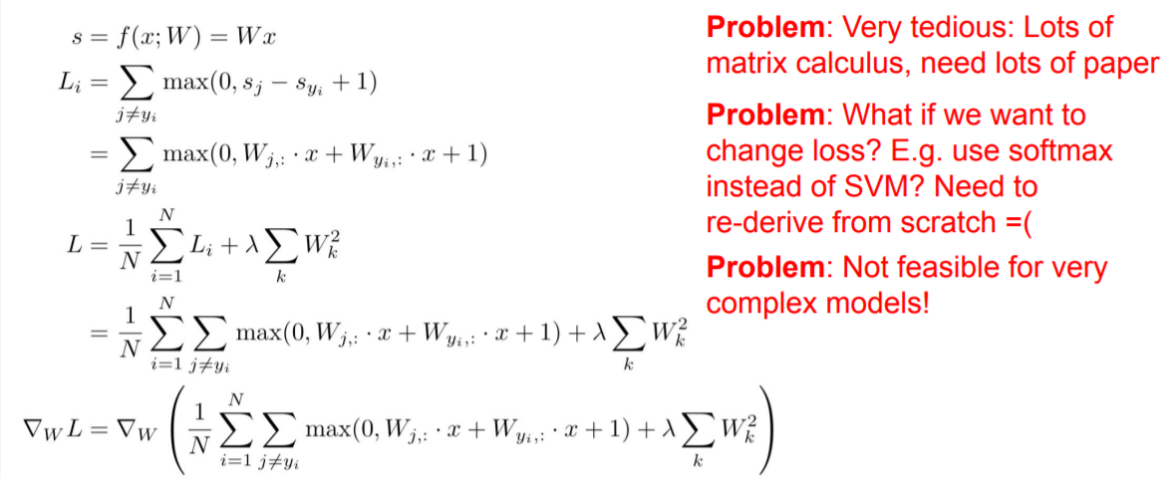
Bad idea- by hand

Slide 9
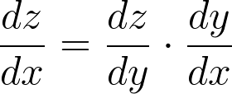
Good idea- back propagation
We are using the chain rule for gradient calculation:
Notes:
\frac{dz}{dx} = \frac{dz}{dy} \cdot \frac{dy}{dx}

Slide 10
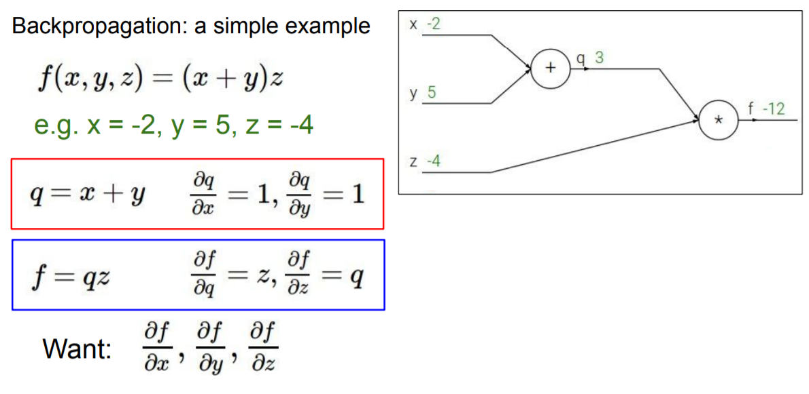

Slide 12
This is called- the forward pass

Slide 13
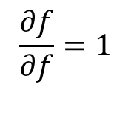
1
Step 0: initialization
$$\frac{∂f}{∂f}=1$$

Slide 14
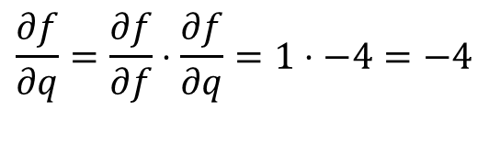
-4
junction
1
Iterative step: chain rule on locale junction.
$$\frac{∂f}{∂q}=\frac{∂f}{∂f}⋅\frac{∂f}{∂q}=1⋅−4=−4$$

Slide 15
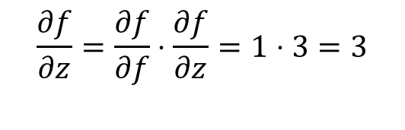
-4
junction
1
3
Iterative step: chain rule on locale junction.
$$\frac{∂f}{∂z}=\frac{∂f}{∂f}⋅\frac{∂f}{∂z}=1⋅3=3$$

Slide 16

-4
junction
1
3
Iterative step: chain rule on locale junction.
$$\frac{∂f}{∂z}=\frac{∂f}{∂f}⋅\frac{∂f}{∂z}=1⋅3=3$$

Slide 17
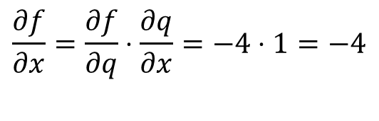
junction
-4
-4
1
3
Iterative step: chain rule on locale junction.
$$\frac{∂f}{∂x}=\frac{∂f}{∂q}⋅\frac{∂q}{∂x}=−4⋅1=−4$$

Slide 18
junction
-4
-4
1
3
Iterative step: chain rule on locale junction.
$$\frac{∂f}{∂x}=\frac{∂f}{∂q}⋅\frac{∂q}{∂x}=−4⋅1=−4$$

Slide 19
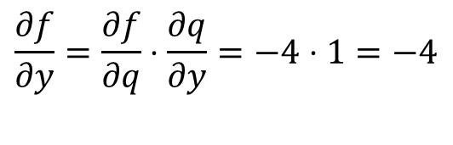
junction
-4
-4
-4
1
3
Iterative step: chain rule on locale junction.
$$\frac{∂f}{∂y}=\frac{∂f}{∂q}⋅\frac{∂q}{∂y}=−4⋅1=−4$$

Slide 20
junction
-4
-4
-4
1
3
Iterative step: chain rule on locale junction.
$$\frac{∂f}{∂y}=\frac{∂f}{∂q}⋅\frac{∂q}{∂y}=−4⋅1=−4$$

Slide 21
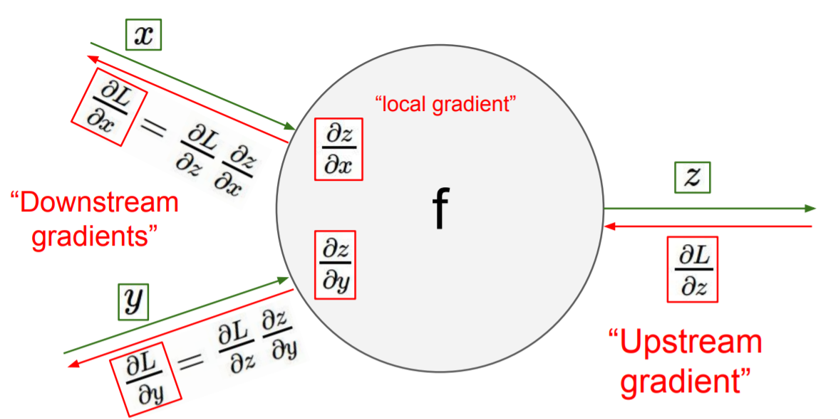
Backpropagation- conclusions
All that we need to know in each junction is:
The local gradient from the junction’s equation.
the chain rule result that was “back propagated” to the junction.

Slide 22
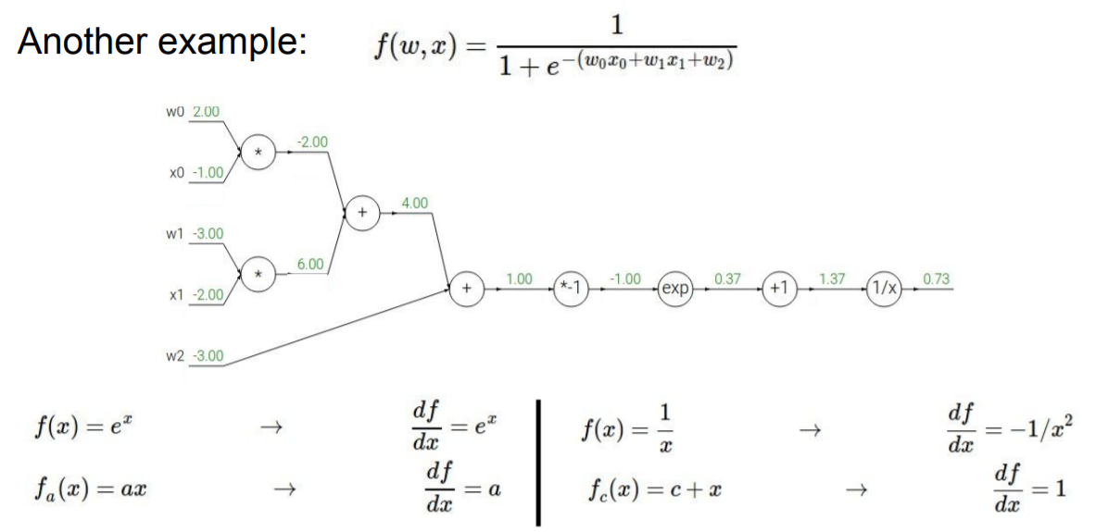
1

Slide 23
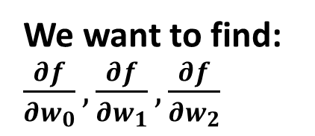
We want to find: $\frac{∂f}{∂w_{0}},\frac{∂f}{∂w_{1}},\frac{∂f}{∂w_{2}}$
1

Slide 24
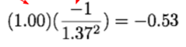
We want to find: $\frac{∂f}{∂w_{0}},\frac{∂f}{∂w_{1}},\frac{∂f}{∂w_{2}}$
-0.53
1

Slide 25
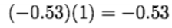
We want to find: $\frac{∂f}{∂w_{0}},\frac{∂f}{∂w_{1}},\frac{∂f}{∂w_{2}}$
-0.53
-0.53
1

Slide 26
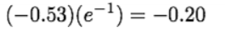
We want to find: $\frac{∂f}{∂w_{0}},\frac{∂f}{∂w_{1}},\frac{∂f}{∂w_{2}}$
-0.2
-0.53
-0.53
1

Slide 27
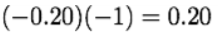
We want to find: $\frac{∂f}{∂w_{0}},\frac{∂f}{∂w_{1}},\frac{∂f}{∂w_{2}}$
0.2
-0.2
-0.53
-0.53
1

Slide 28
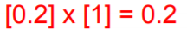
We want to find: $\frac{∂f}{∂w_{0}},\frac{∂f}{∂w_{1}},\frac{∂f}{∂w_{2}}$
0.2
0.2
-0.2
-0.53
-0.53
1

Slide 29
We want to find: $\frac{∂f}{∂w_{0}},\frac{∂f}{∂w_{1}},\frac{∂f}{∂w_{2}}$
0.2
0.2
-0.2
-0.53
-0.53
1
0.2

Slide 30
We want to find: $\frac{∂f}{∂w_{0}},\frac{∂f}{∂w_{1}},\frac{∂f}{∂w_{2}}$
0.2
0.2
0.2
-0.2
-0.53
-0.53
1
0.2

Slide 31
We want to find: $\frac{∂f}{∂w_{0}},\frac{∂f}{∂w_{1}},\frac{∂f}{∂w_{2}}$
0.2
0.2
0.2
0.2
-0.2
-0.53
-0.53
1
0.2

Slide 32
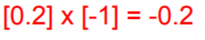
We want to find: $\frac{∂f}{∂w_{0}},\frac{∂f}{∂w_{1}},\frac{∂f}{∂w_{2}}$
-0.2
0.2
0.2
0.2
0.2
-0.2
-0.53
-0.53
1
0.2

Slide 33
We want to find: $\frac{∂f}{∂w_{0}},\frac{∂f}{∂w_{1}},\frac{∂f}{∂w_{2}}$
-0.2
0.2
[0.2]*[-2]=-0.4
0.2
-0.4
0.2
0.2
-0.2
-0.53
-0.53
1
0.2

Slide 34
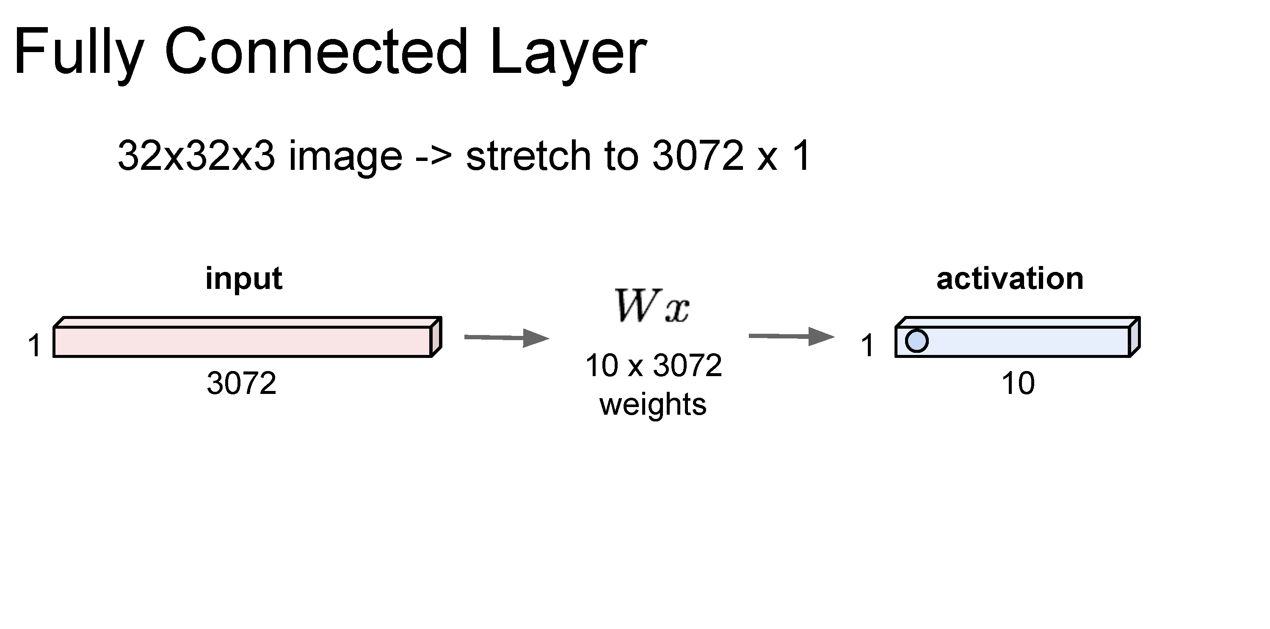

Slide 35
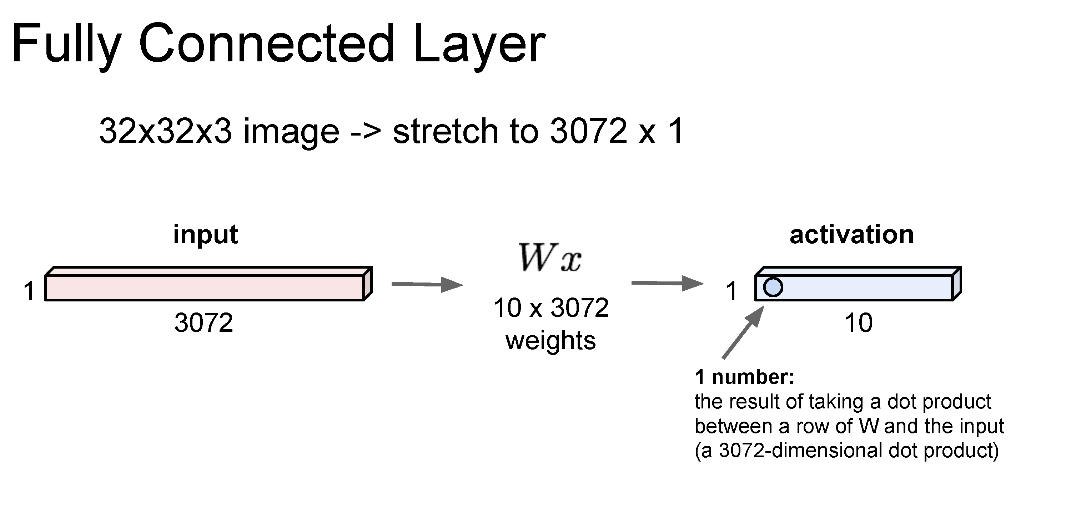
Same as a linear classifier!

Slide 36
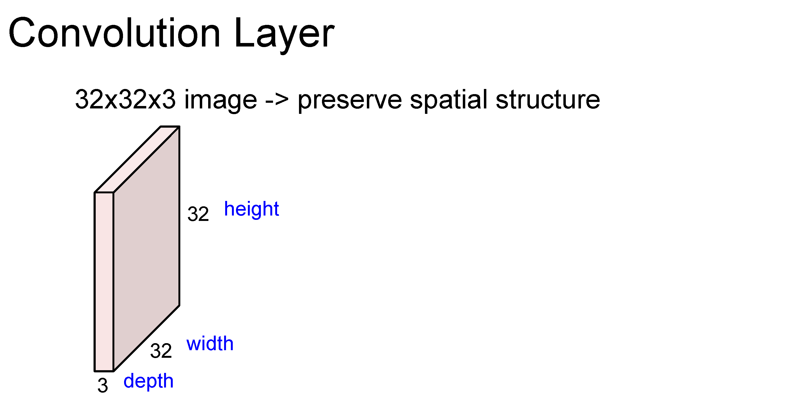

Slide 37
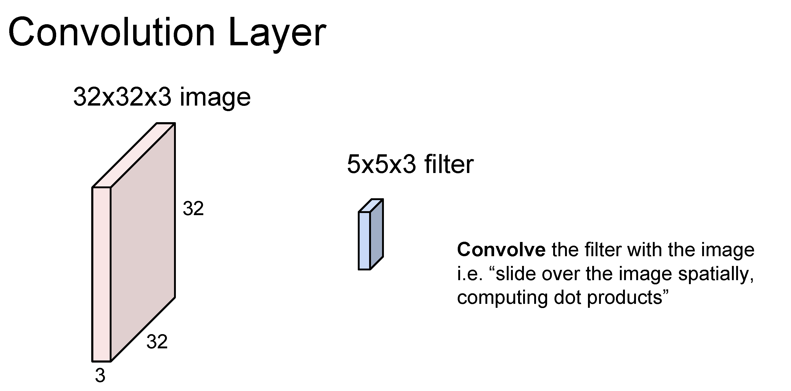

Slide 38
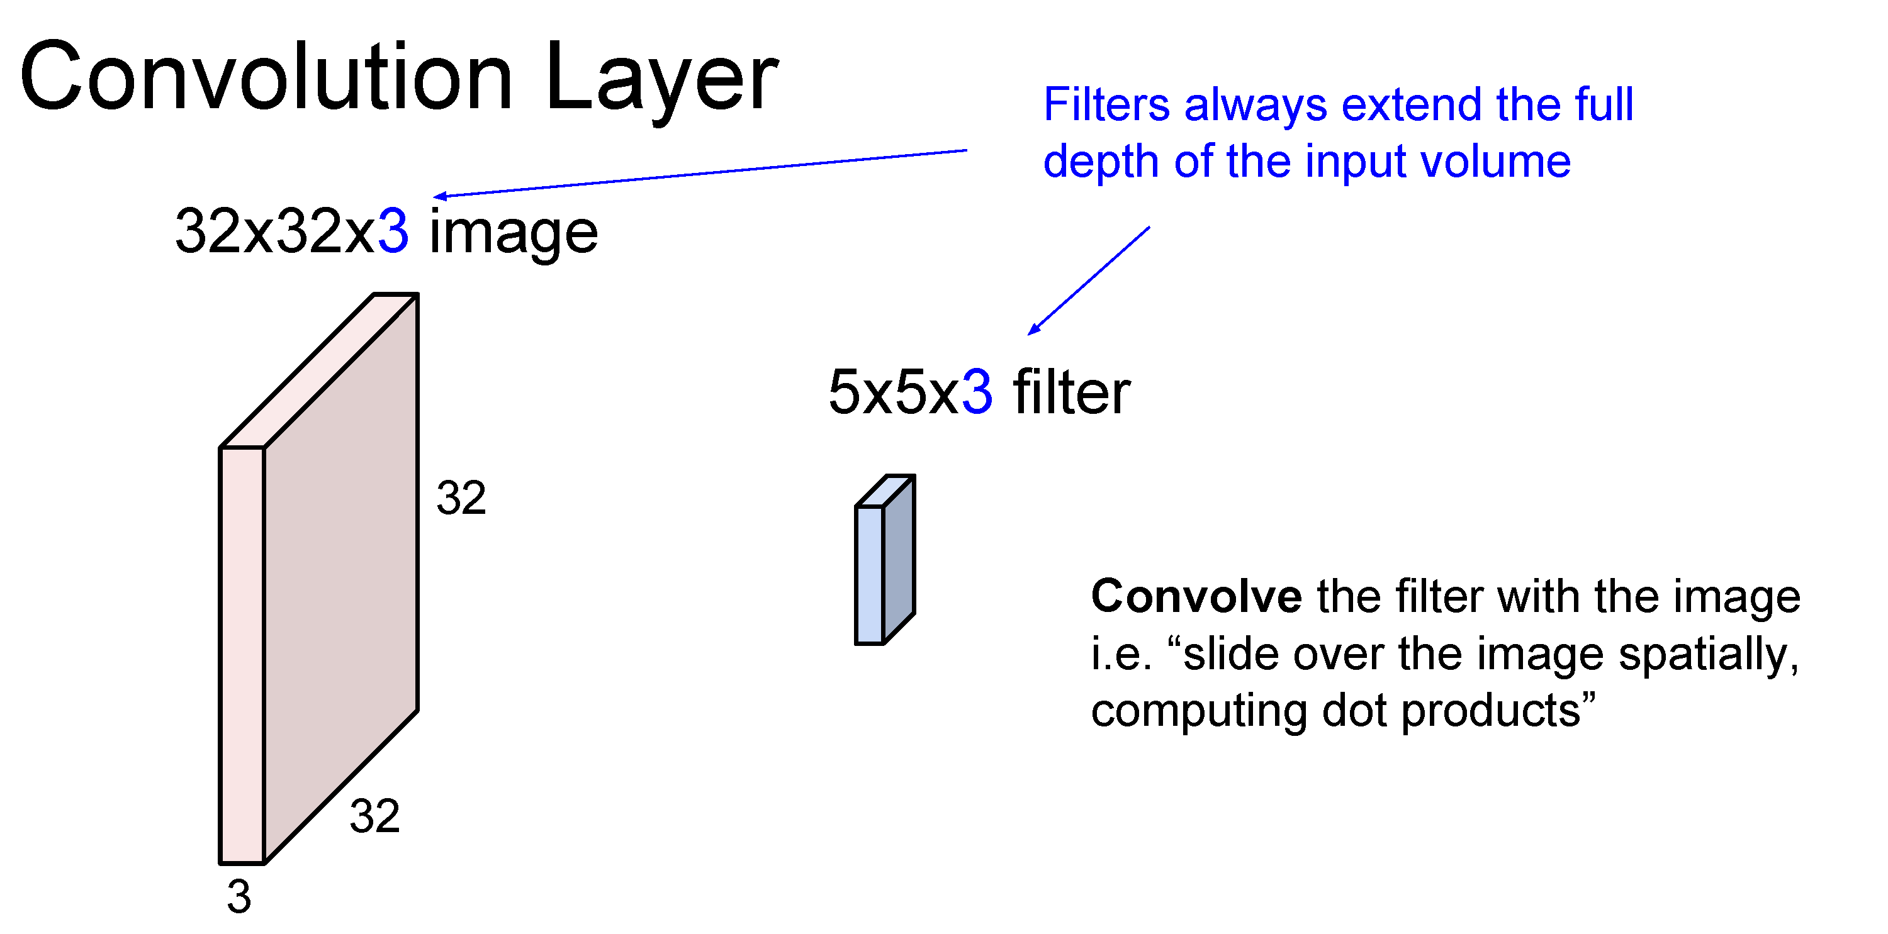

Slide 39
Number of weights: 5 x 5 x 3 + 1 = 76
(vs. 3072 for a fully-connected layer)
(+1 for bias)

Slide 40
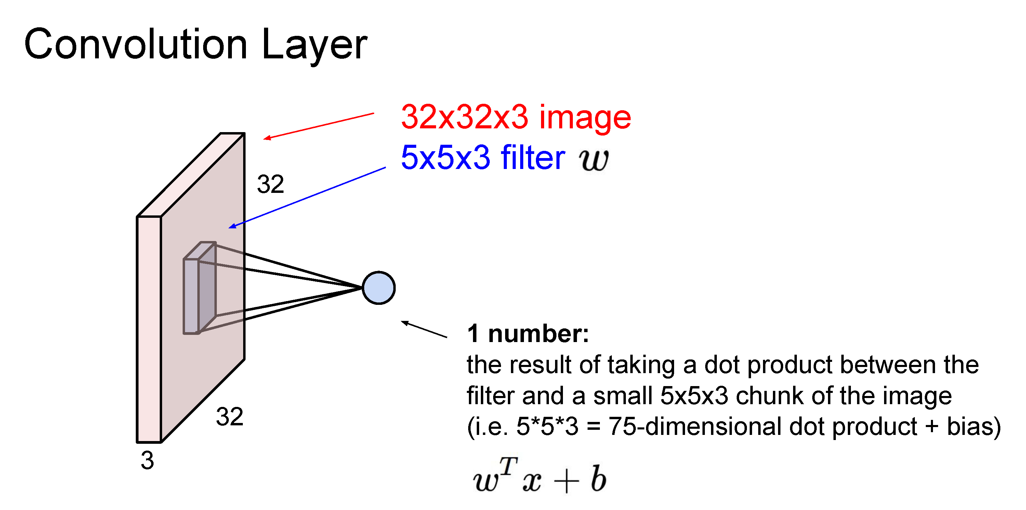

Slide 41
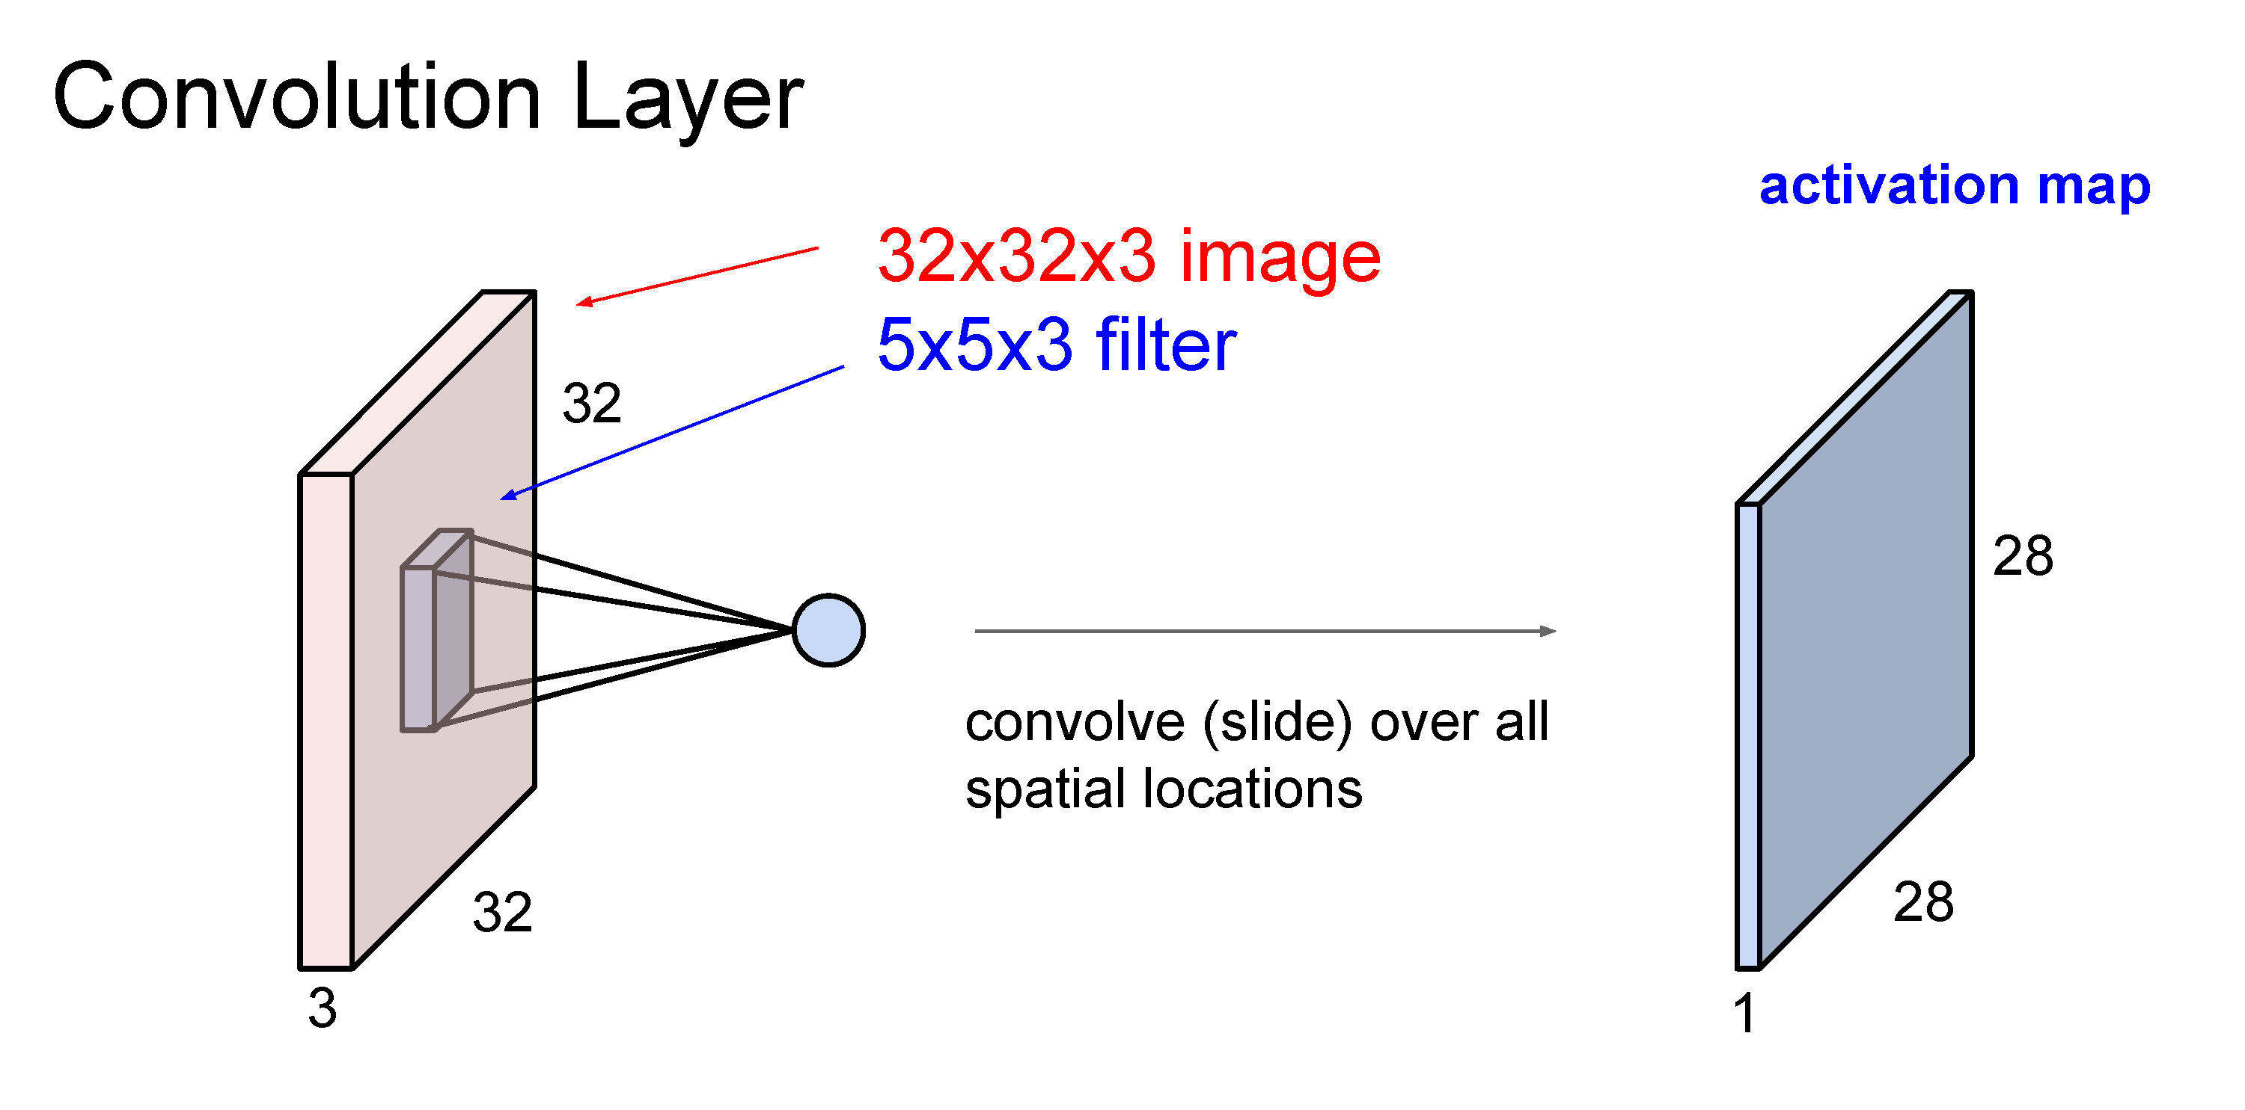

Slide 42
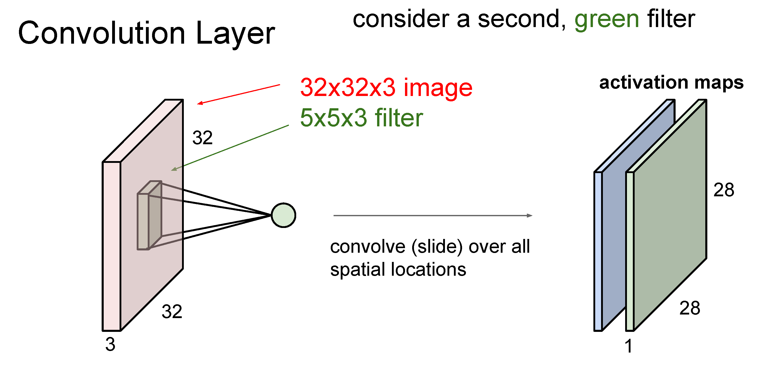

Slide 43
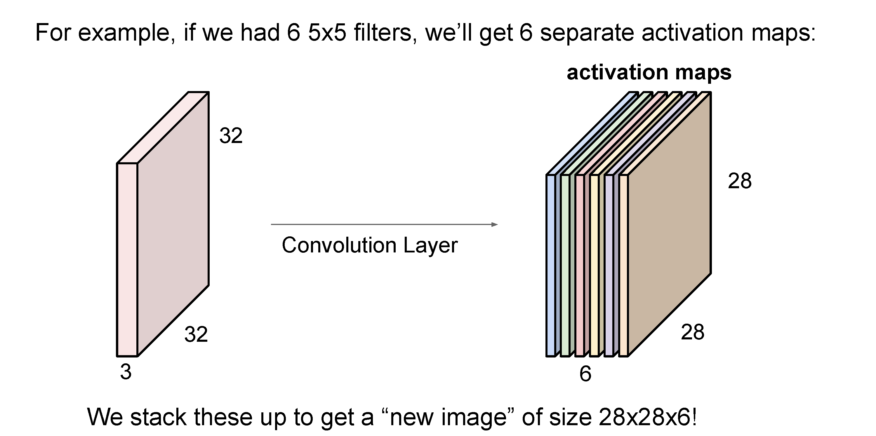
(total number of parameters: 6 x (75 + 1) = 456)

Slide 44
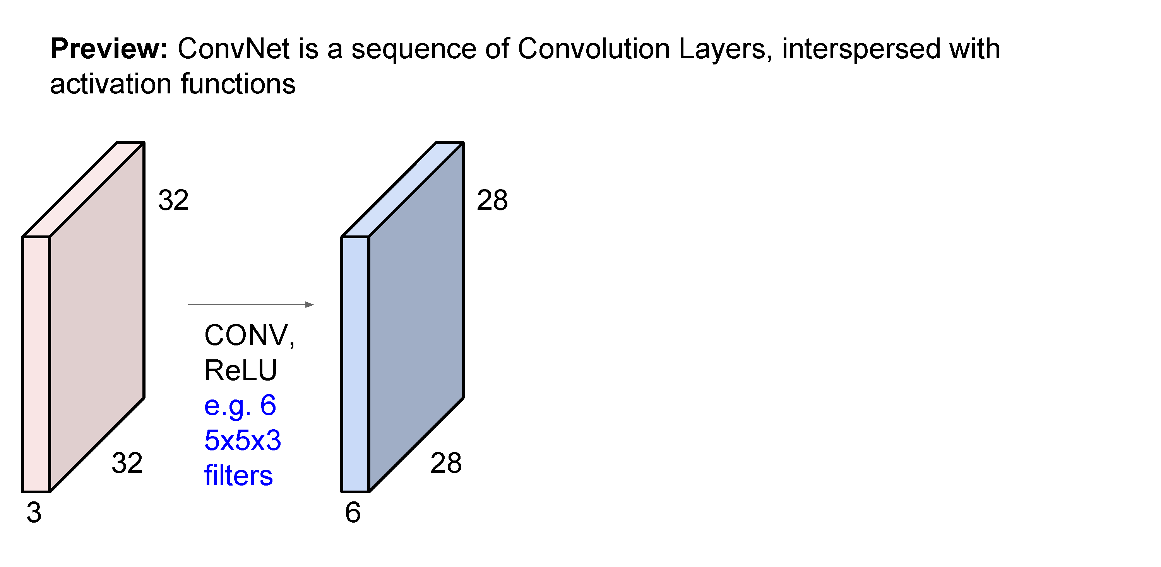

Slide 45
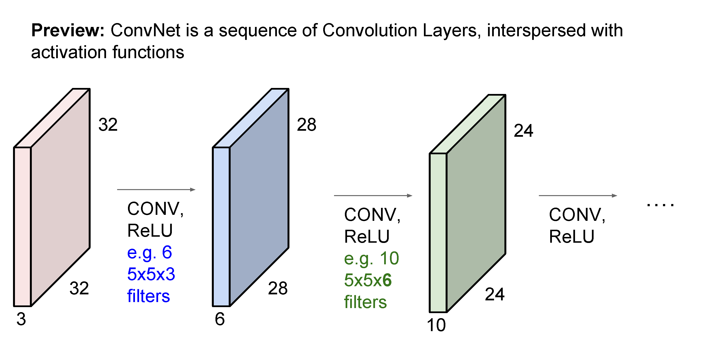

Slide 46
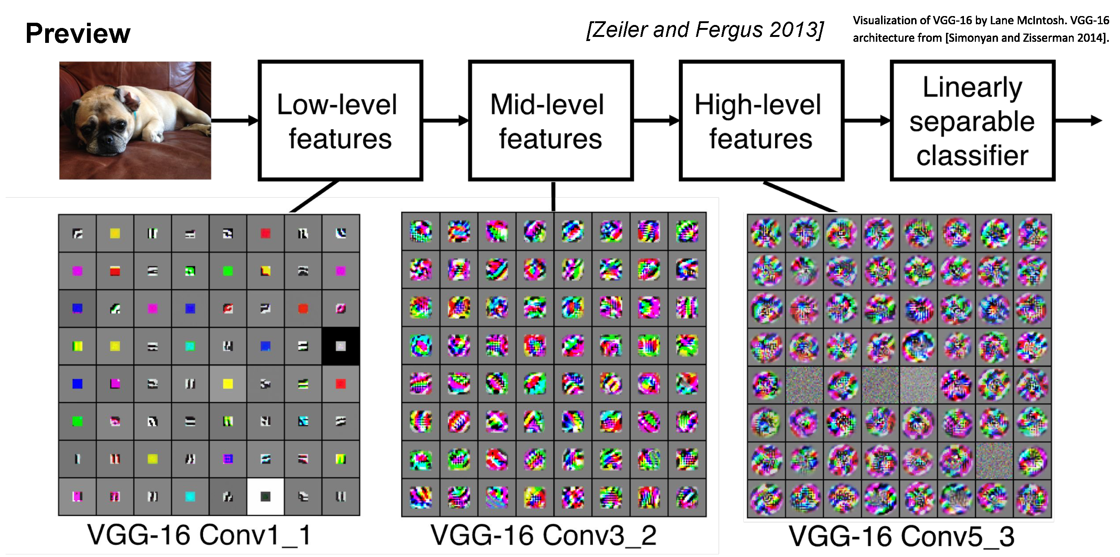

Slide 47
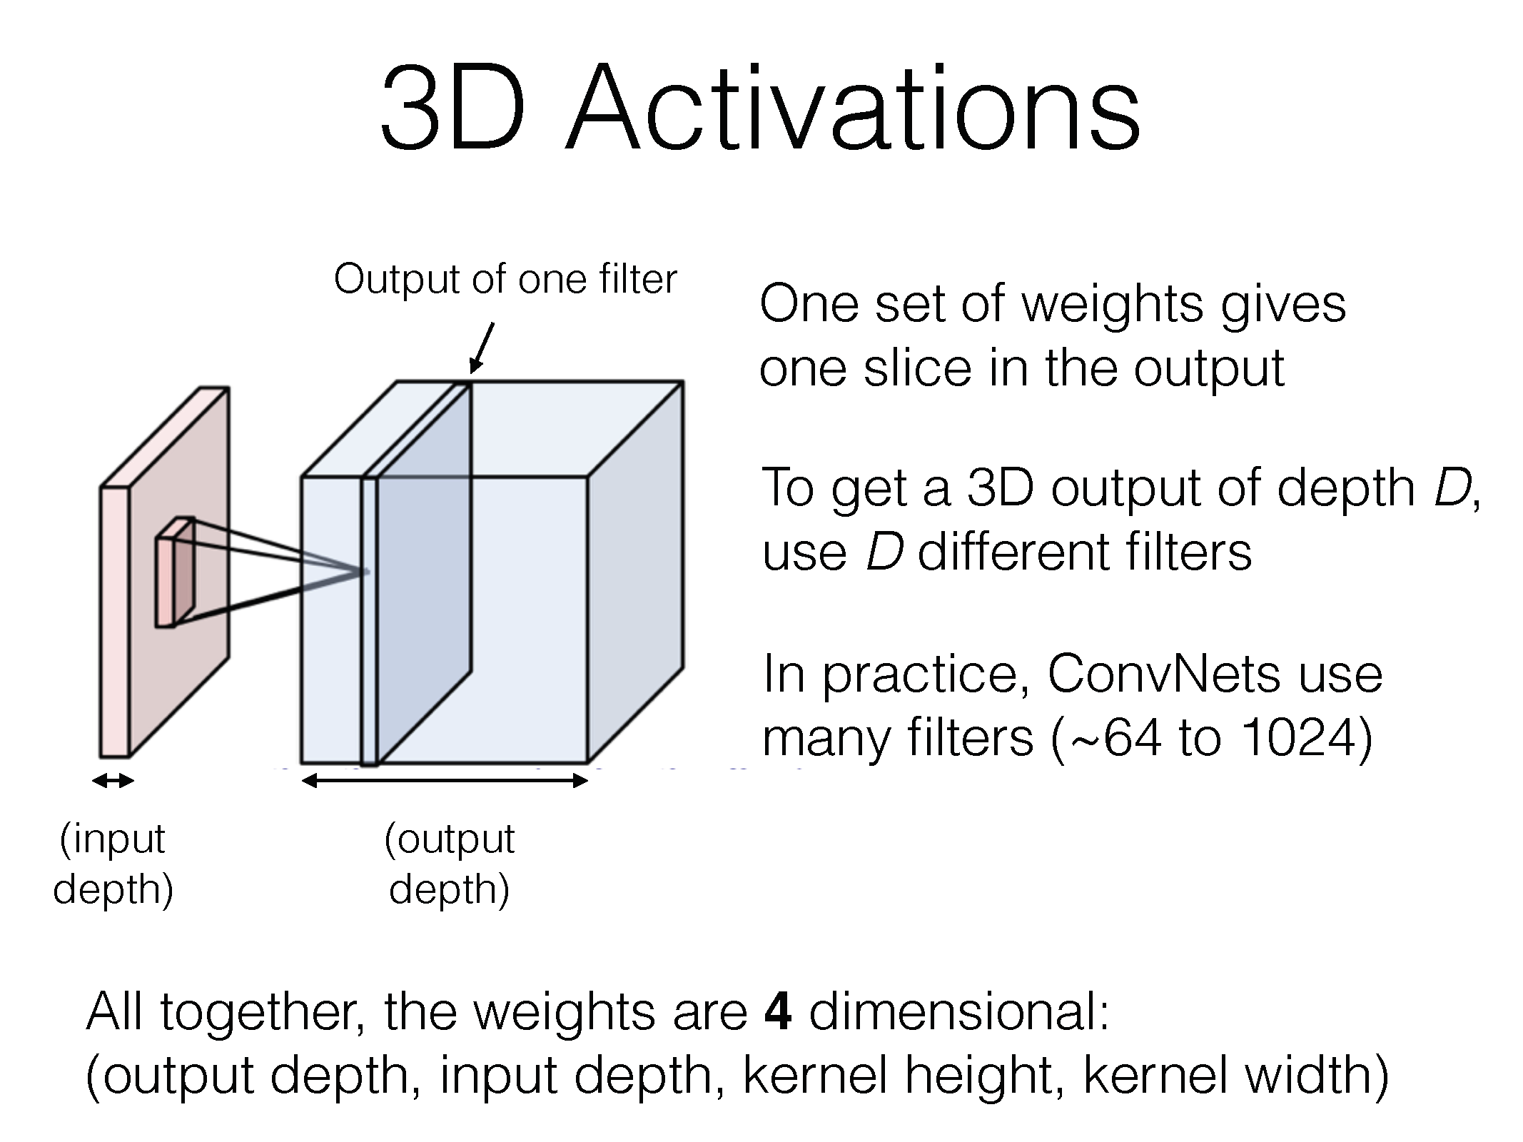

Slide 48
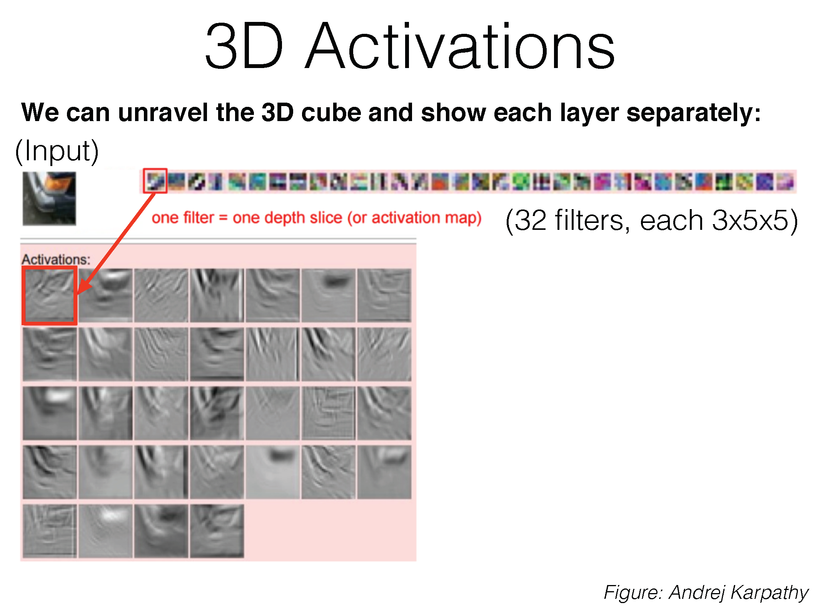

Slide 49
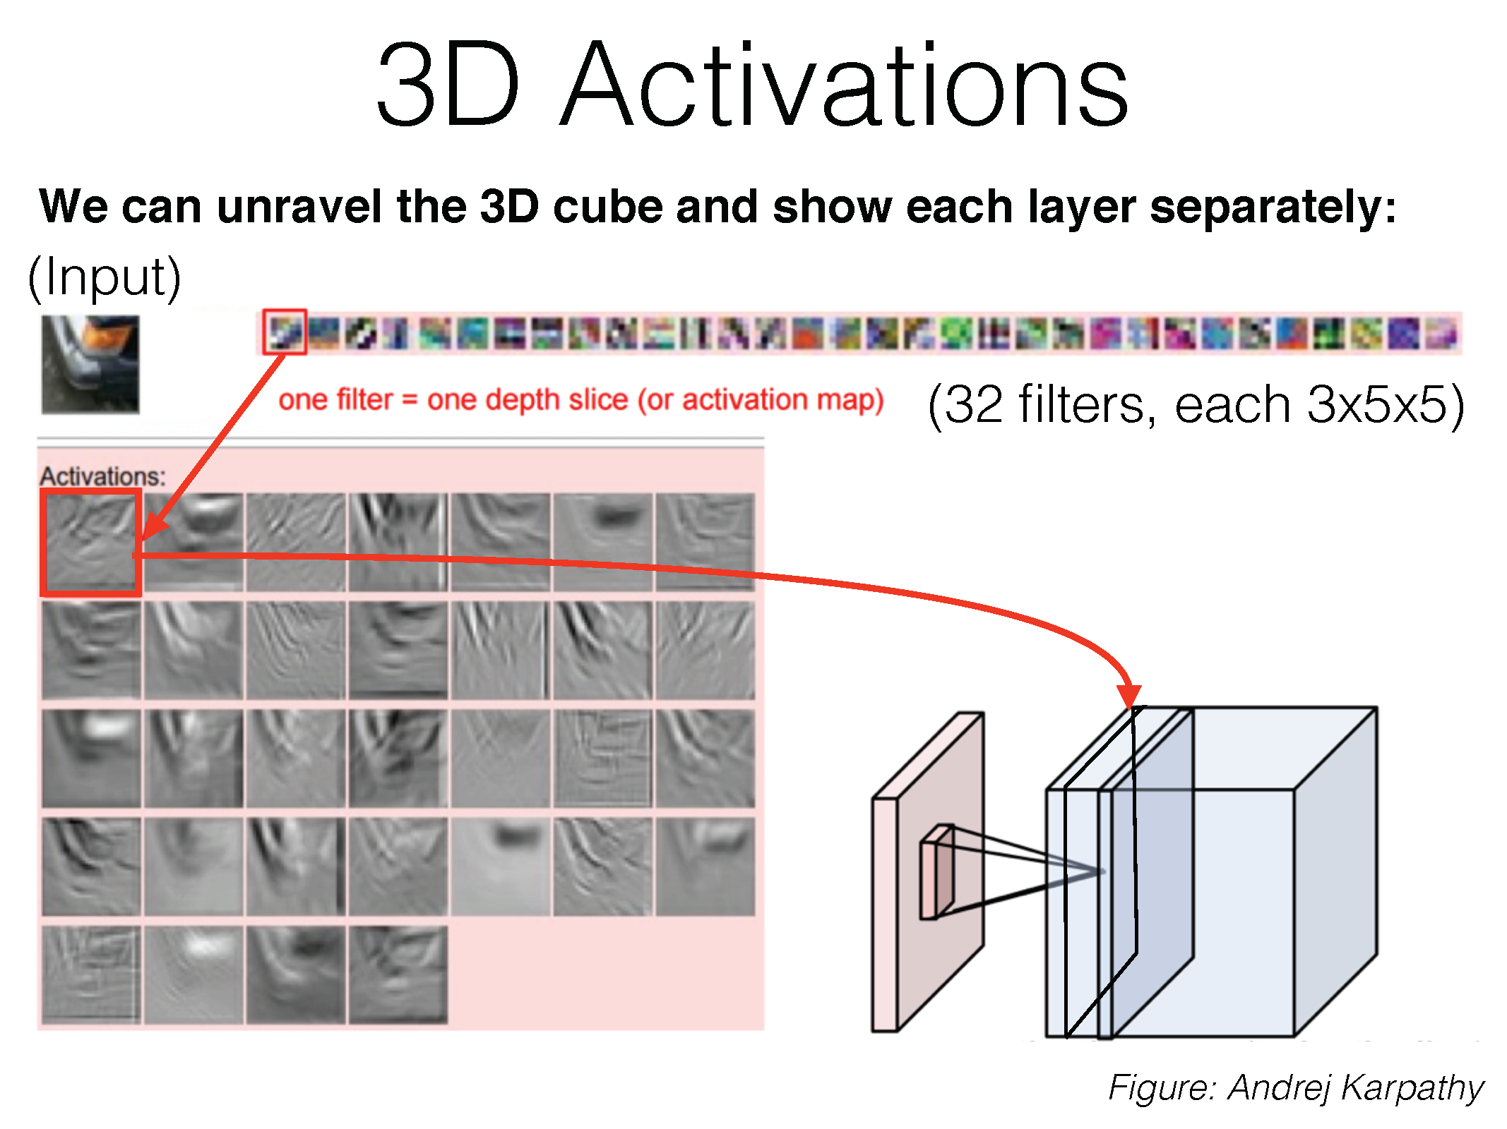

Slide 50
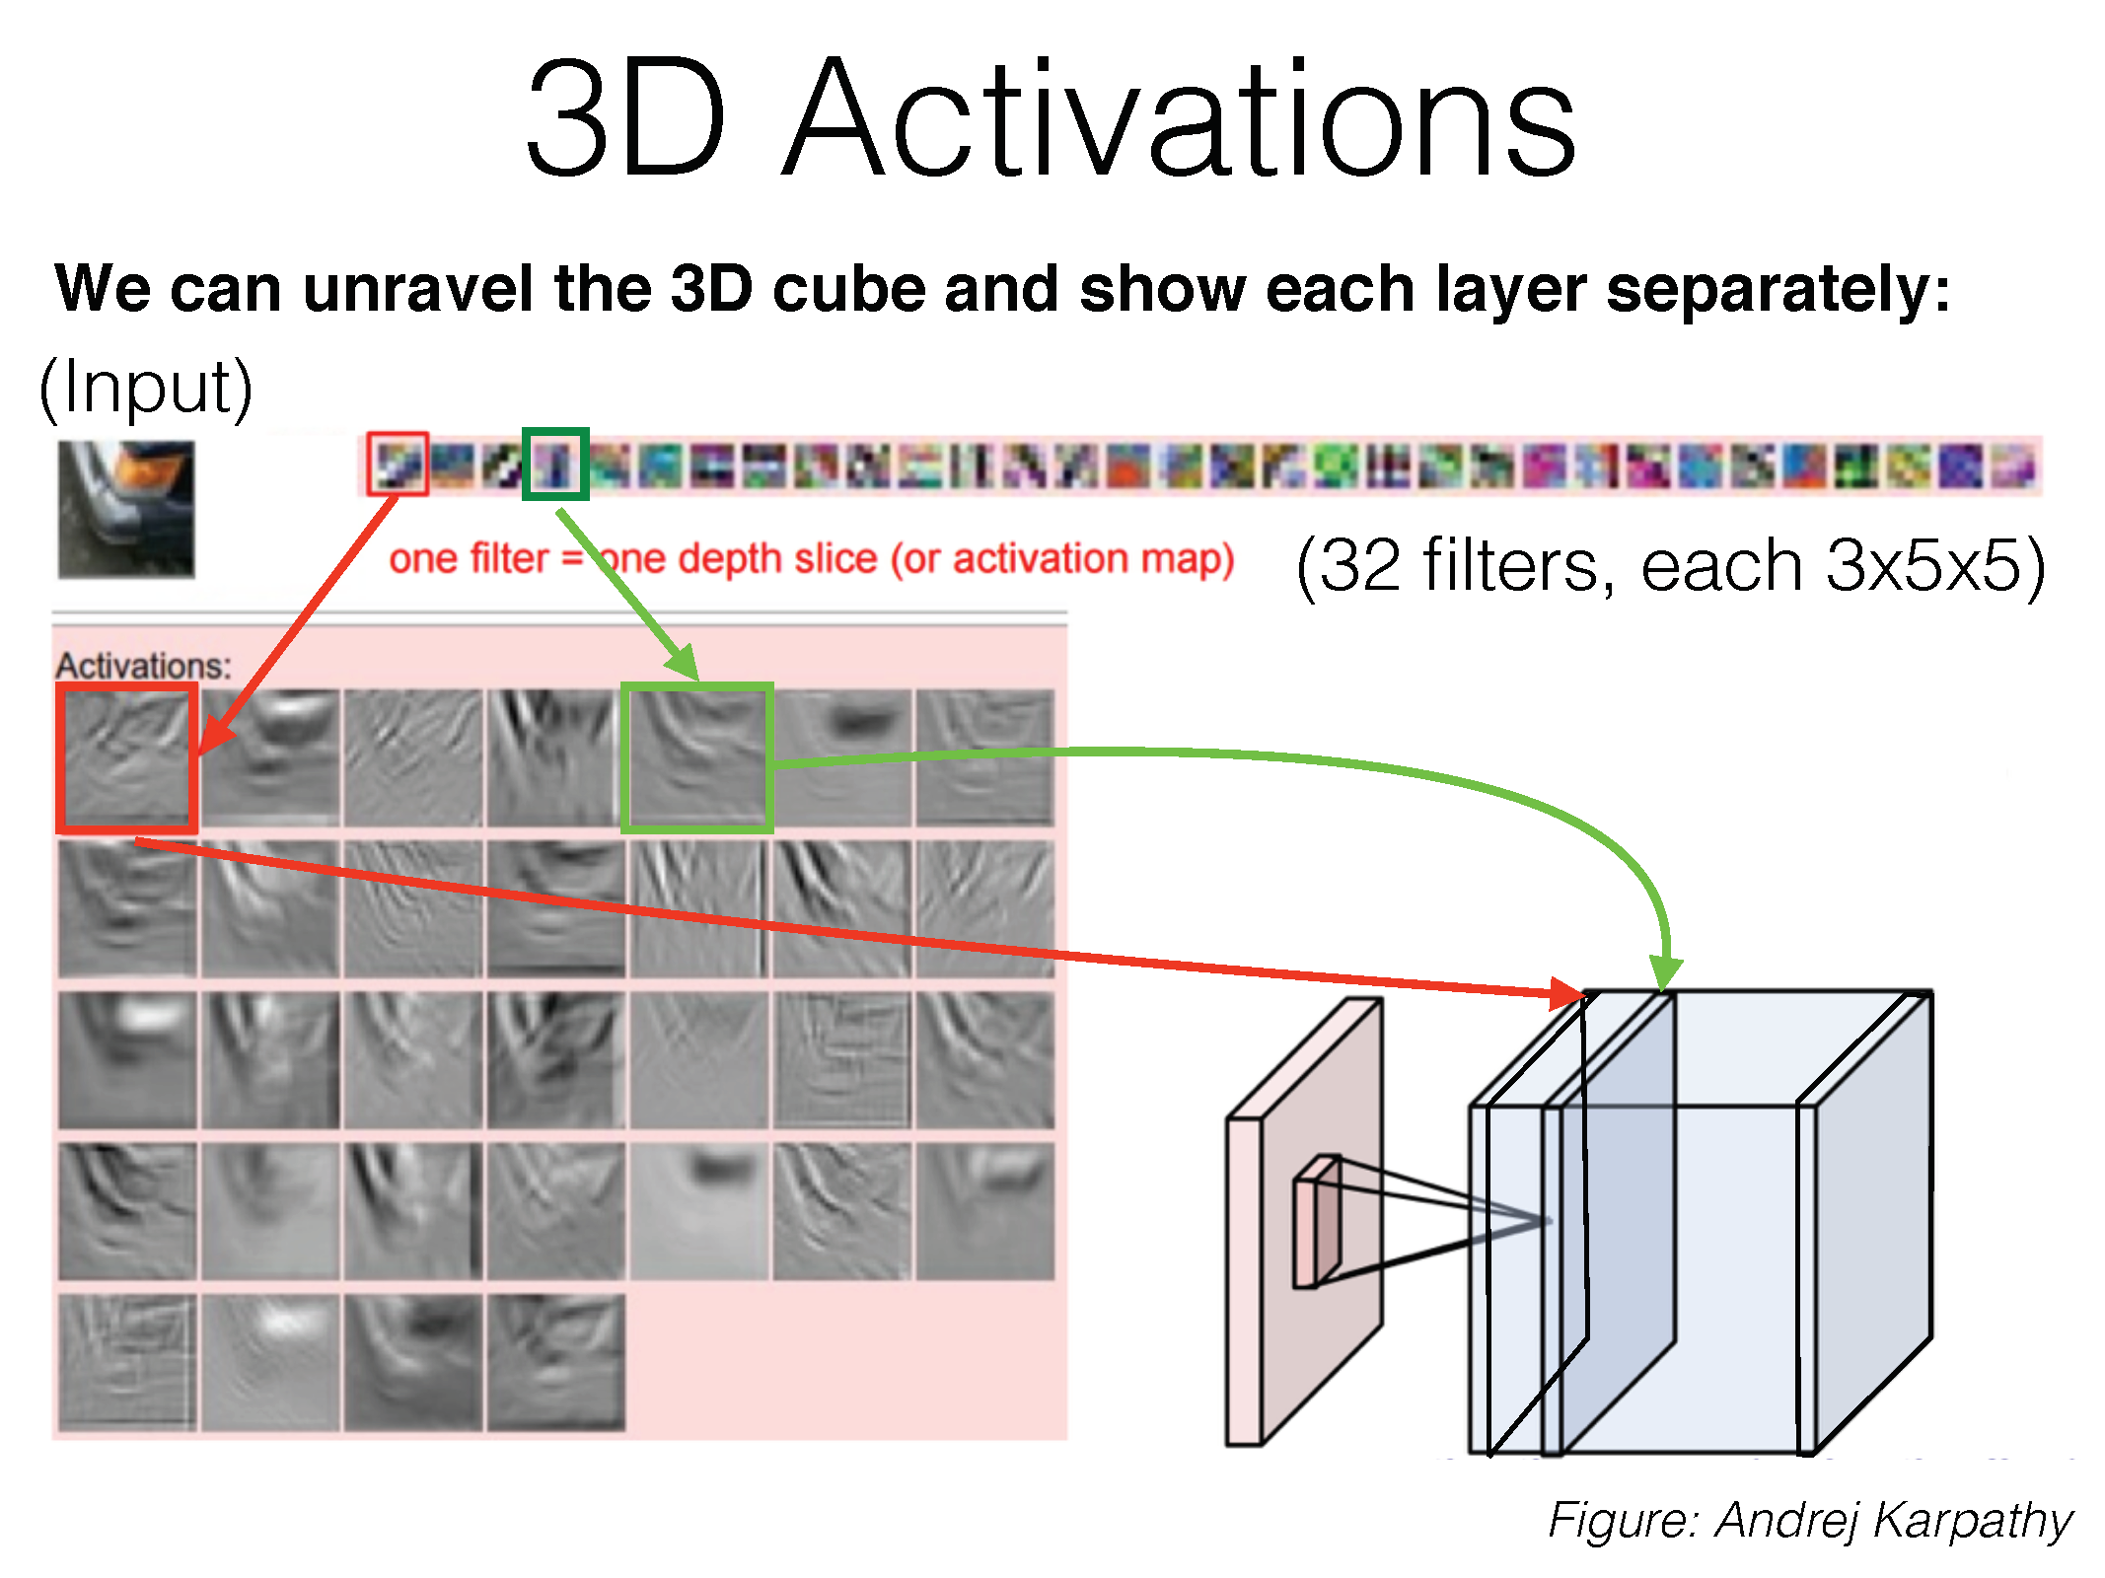

Slide 51
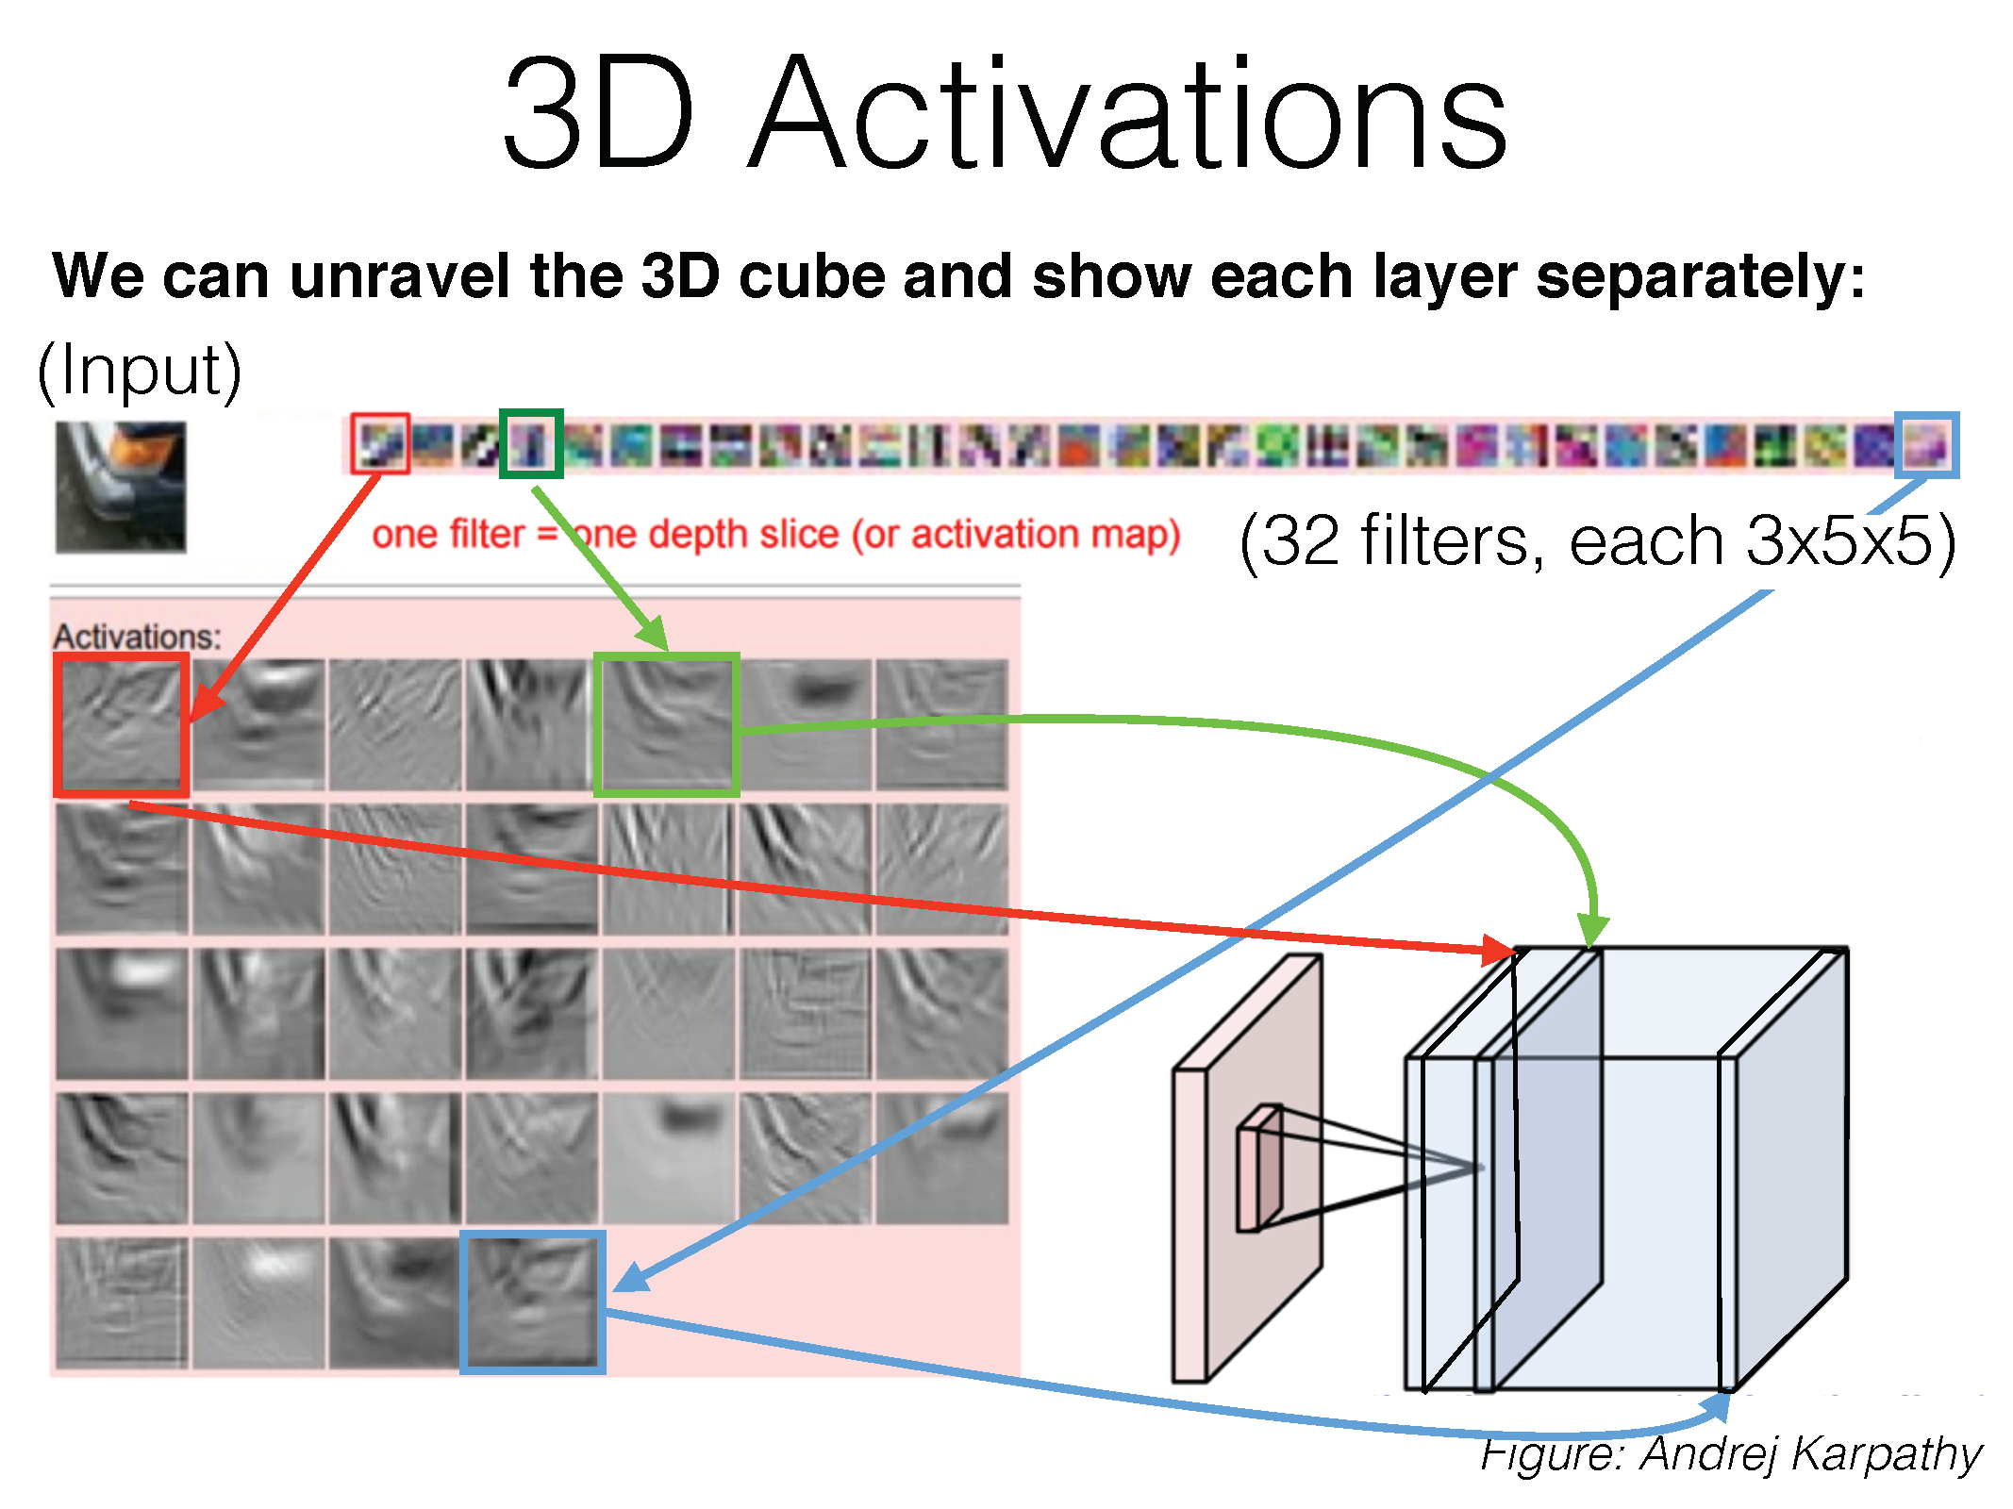

Slide 52
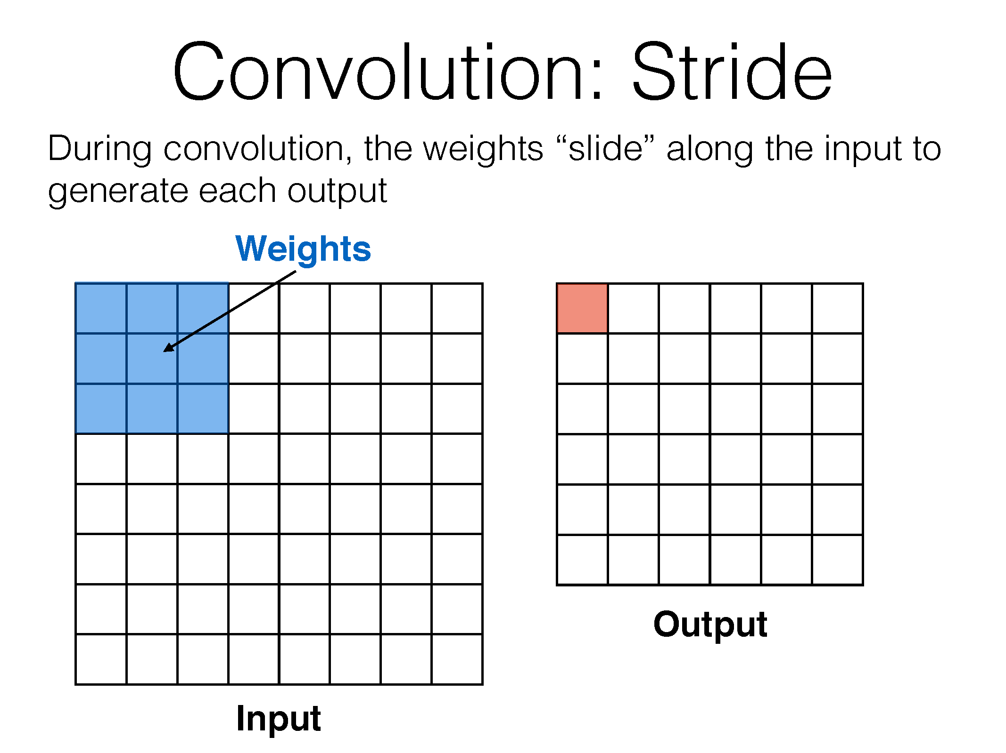

Slide 53
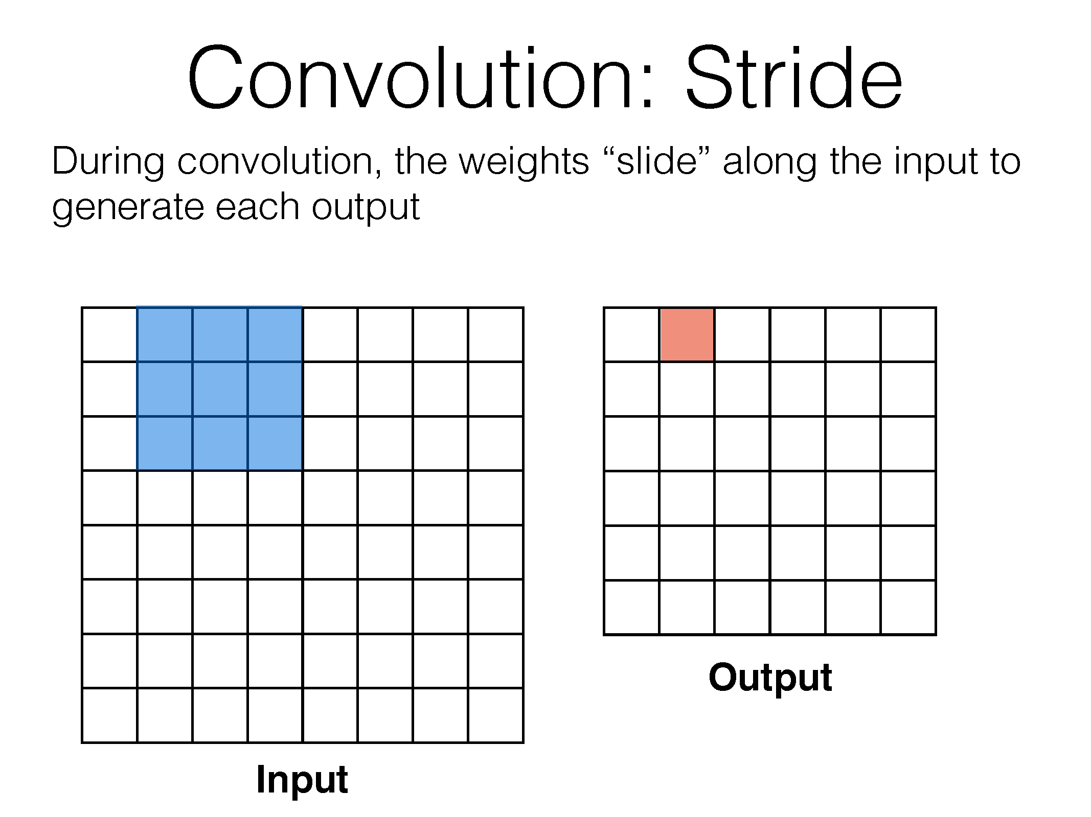

Slide 54
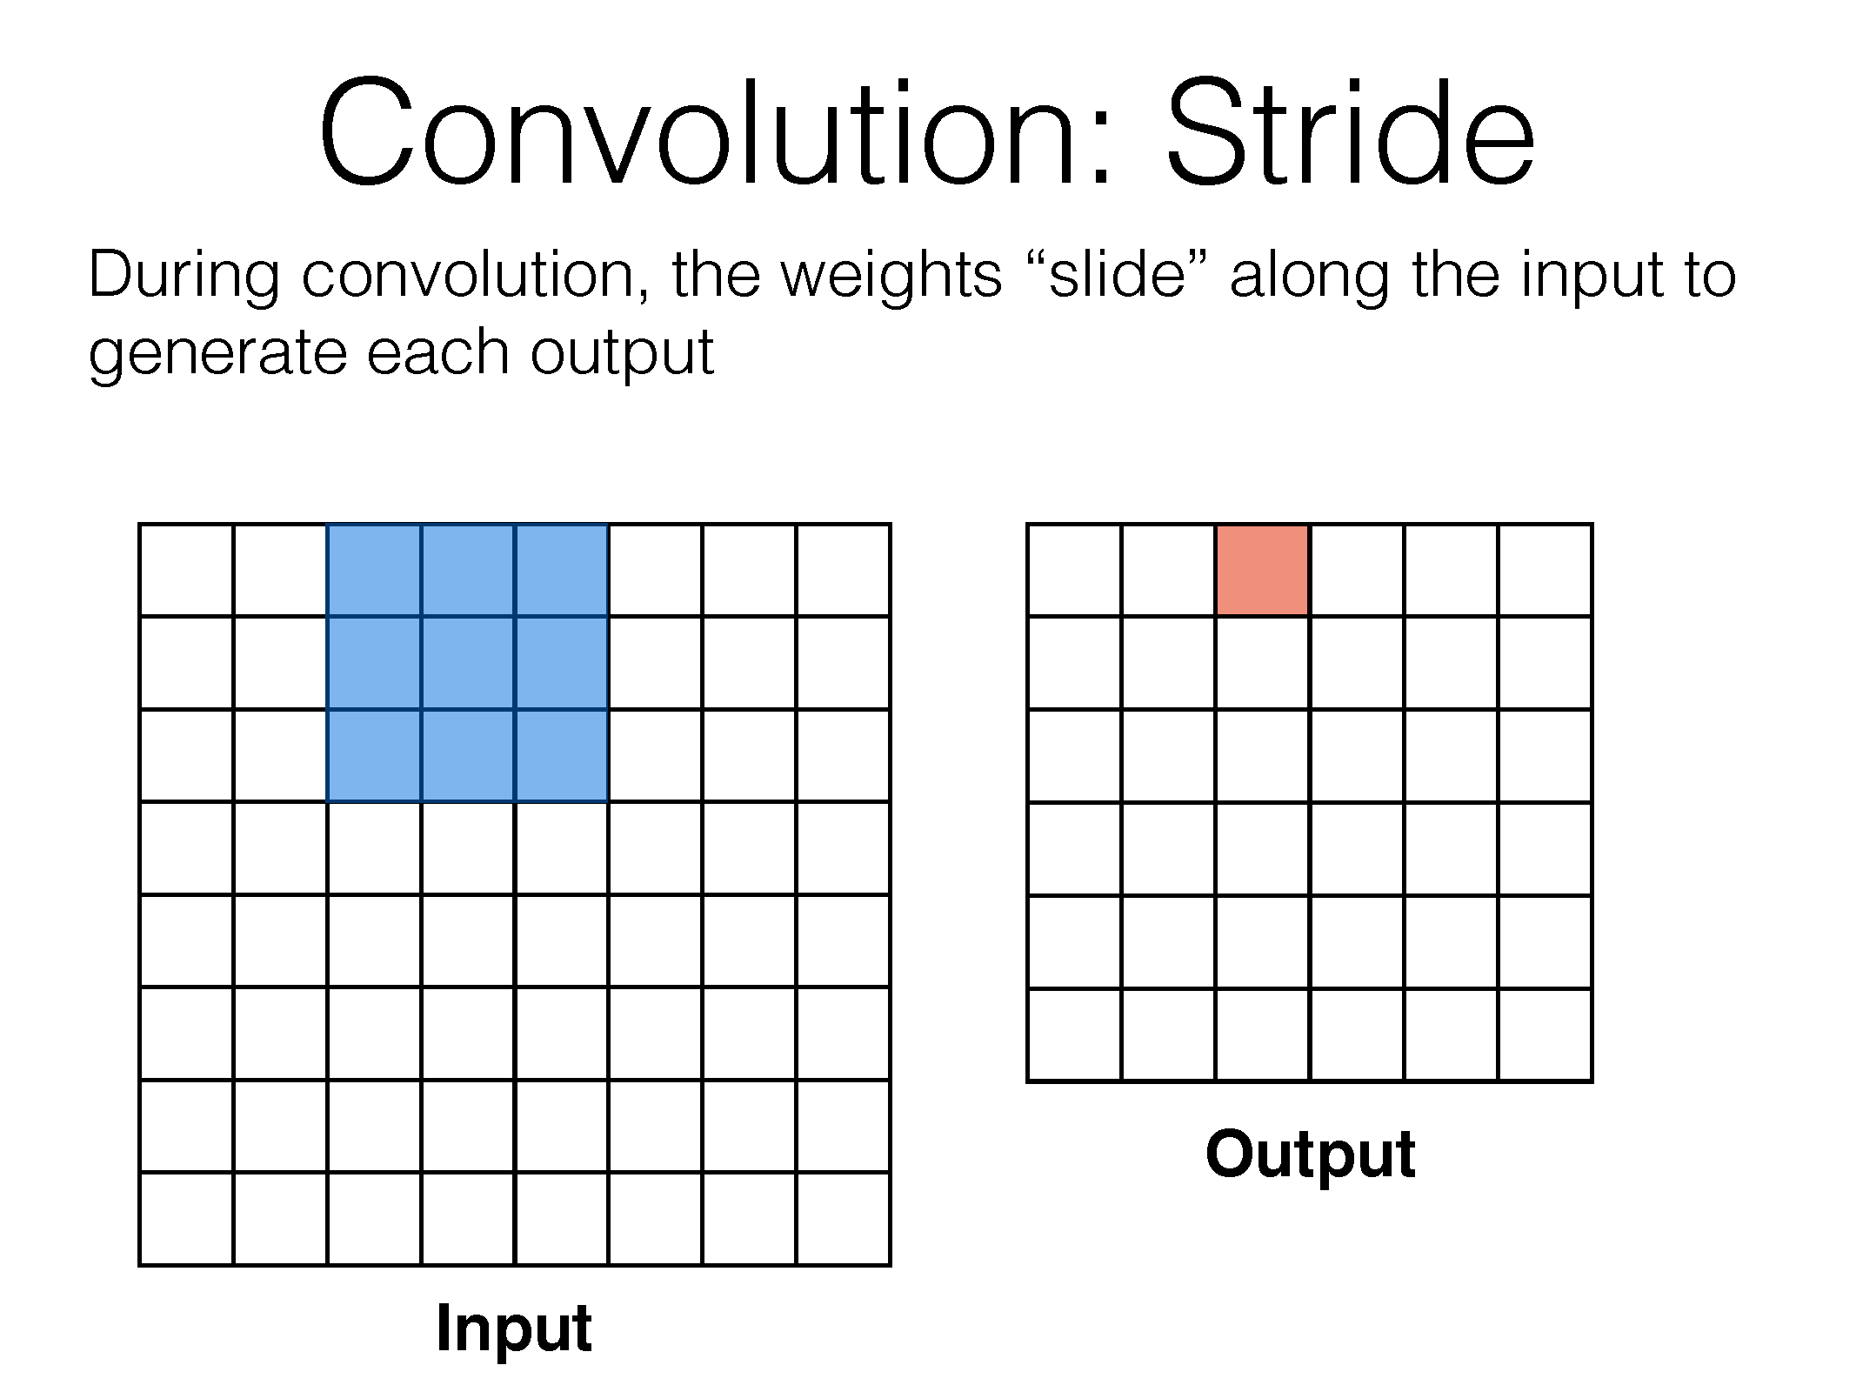

Slide 55
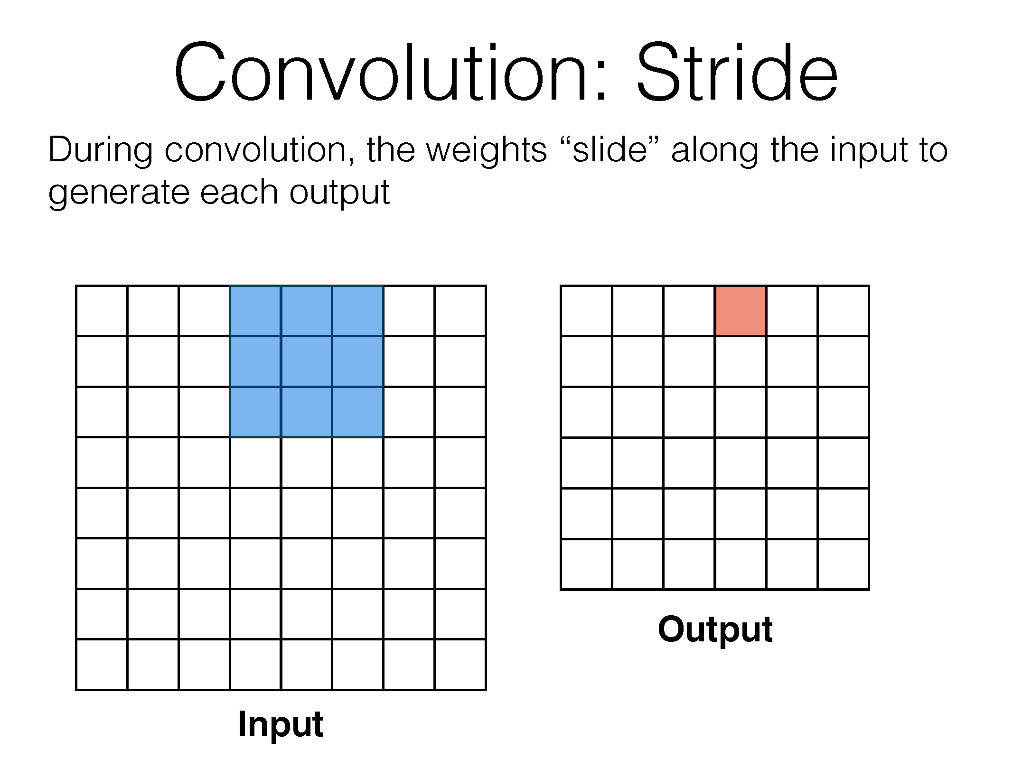

Slide 56
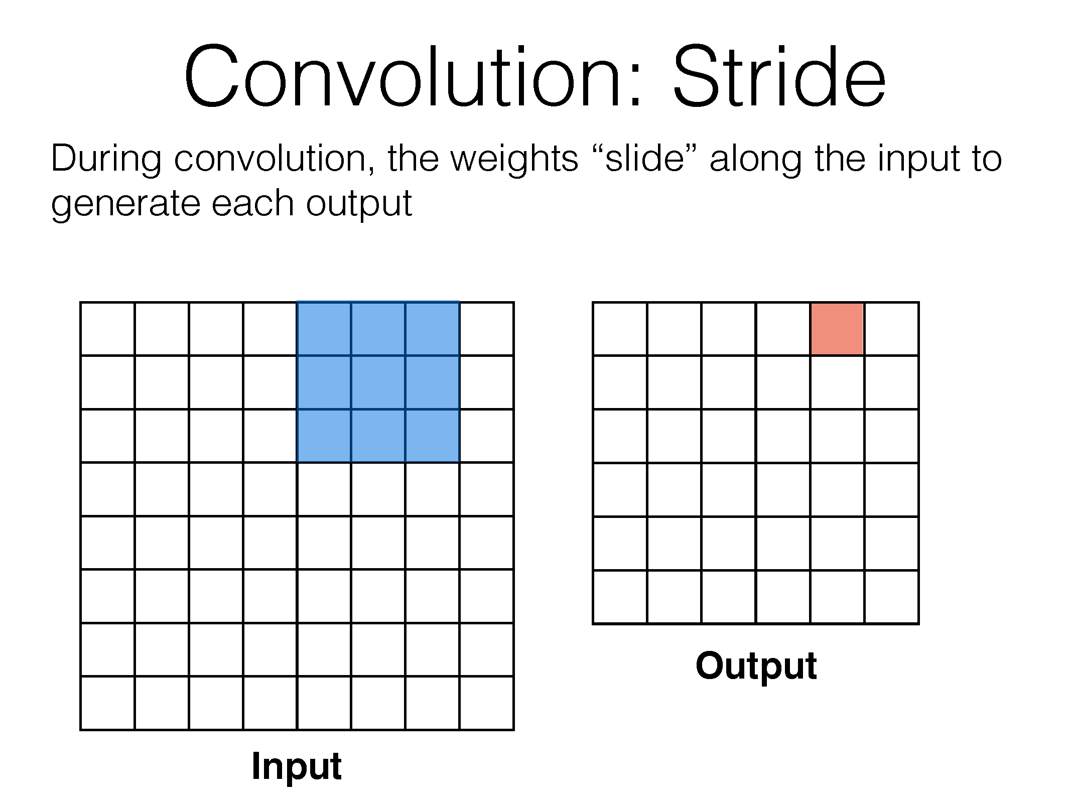

Slide 57
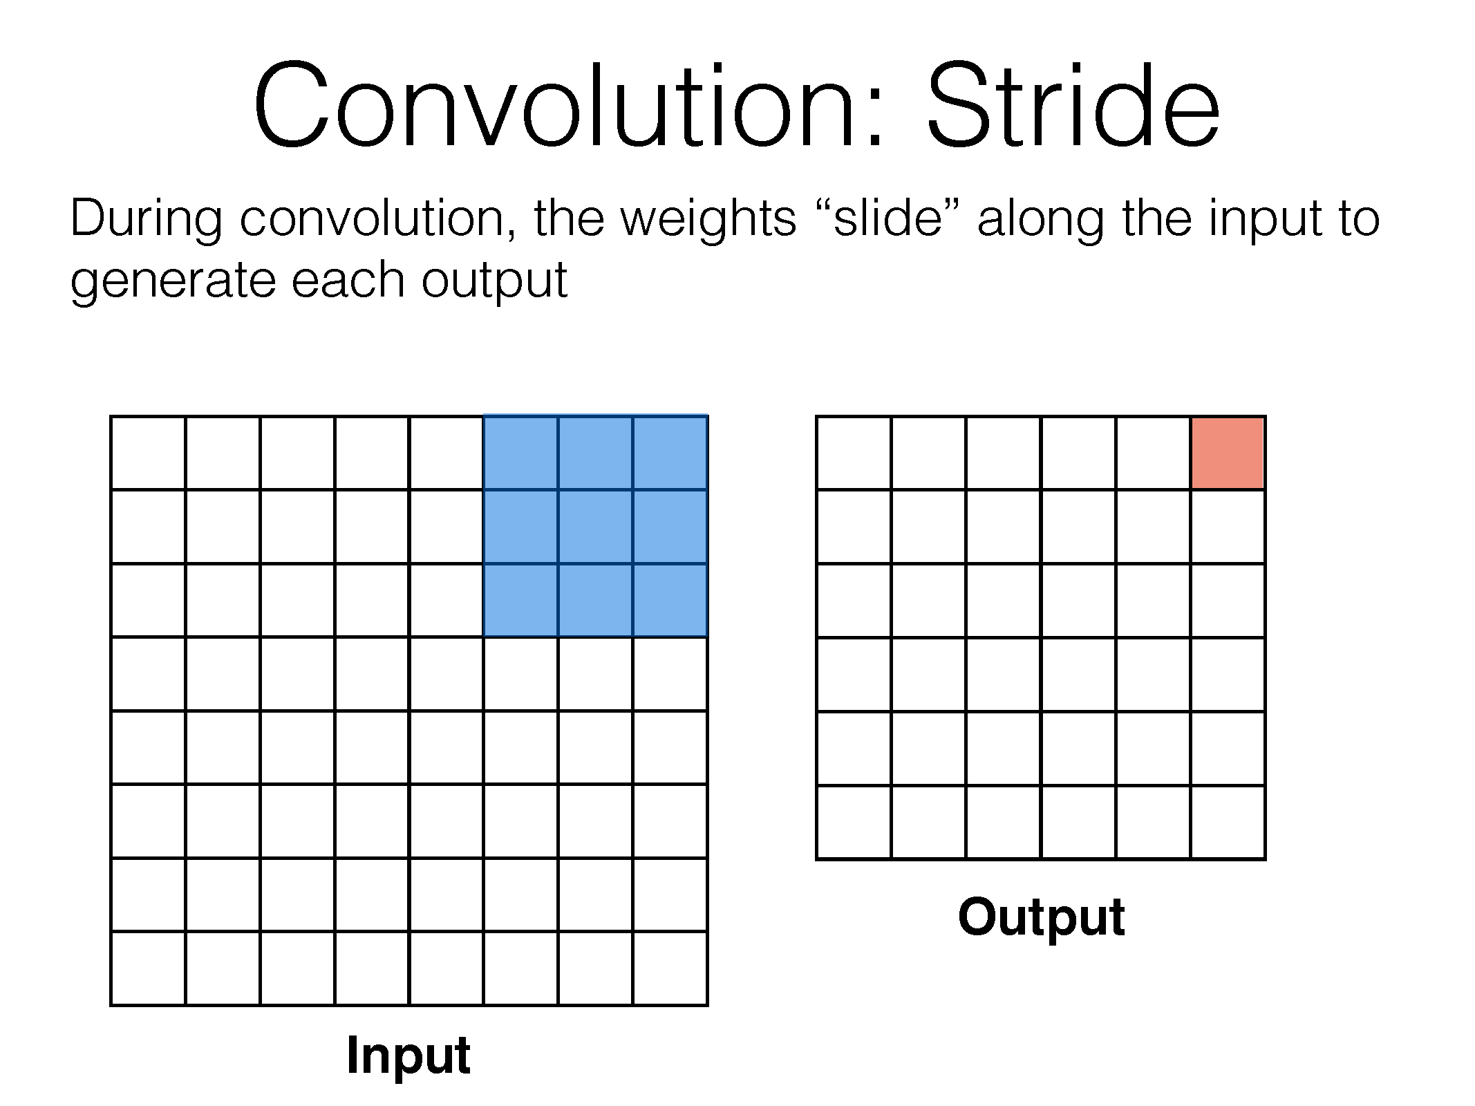

Slide 58
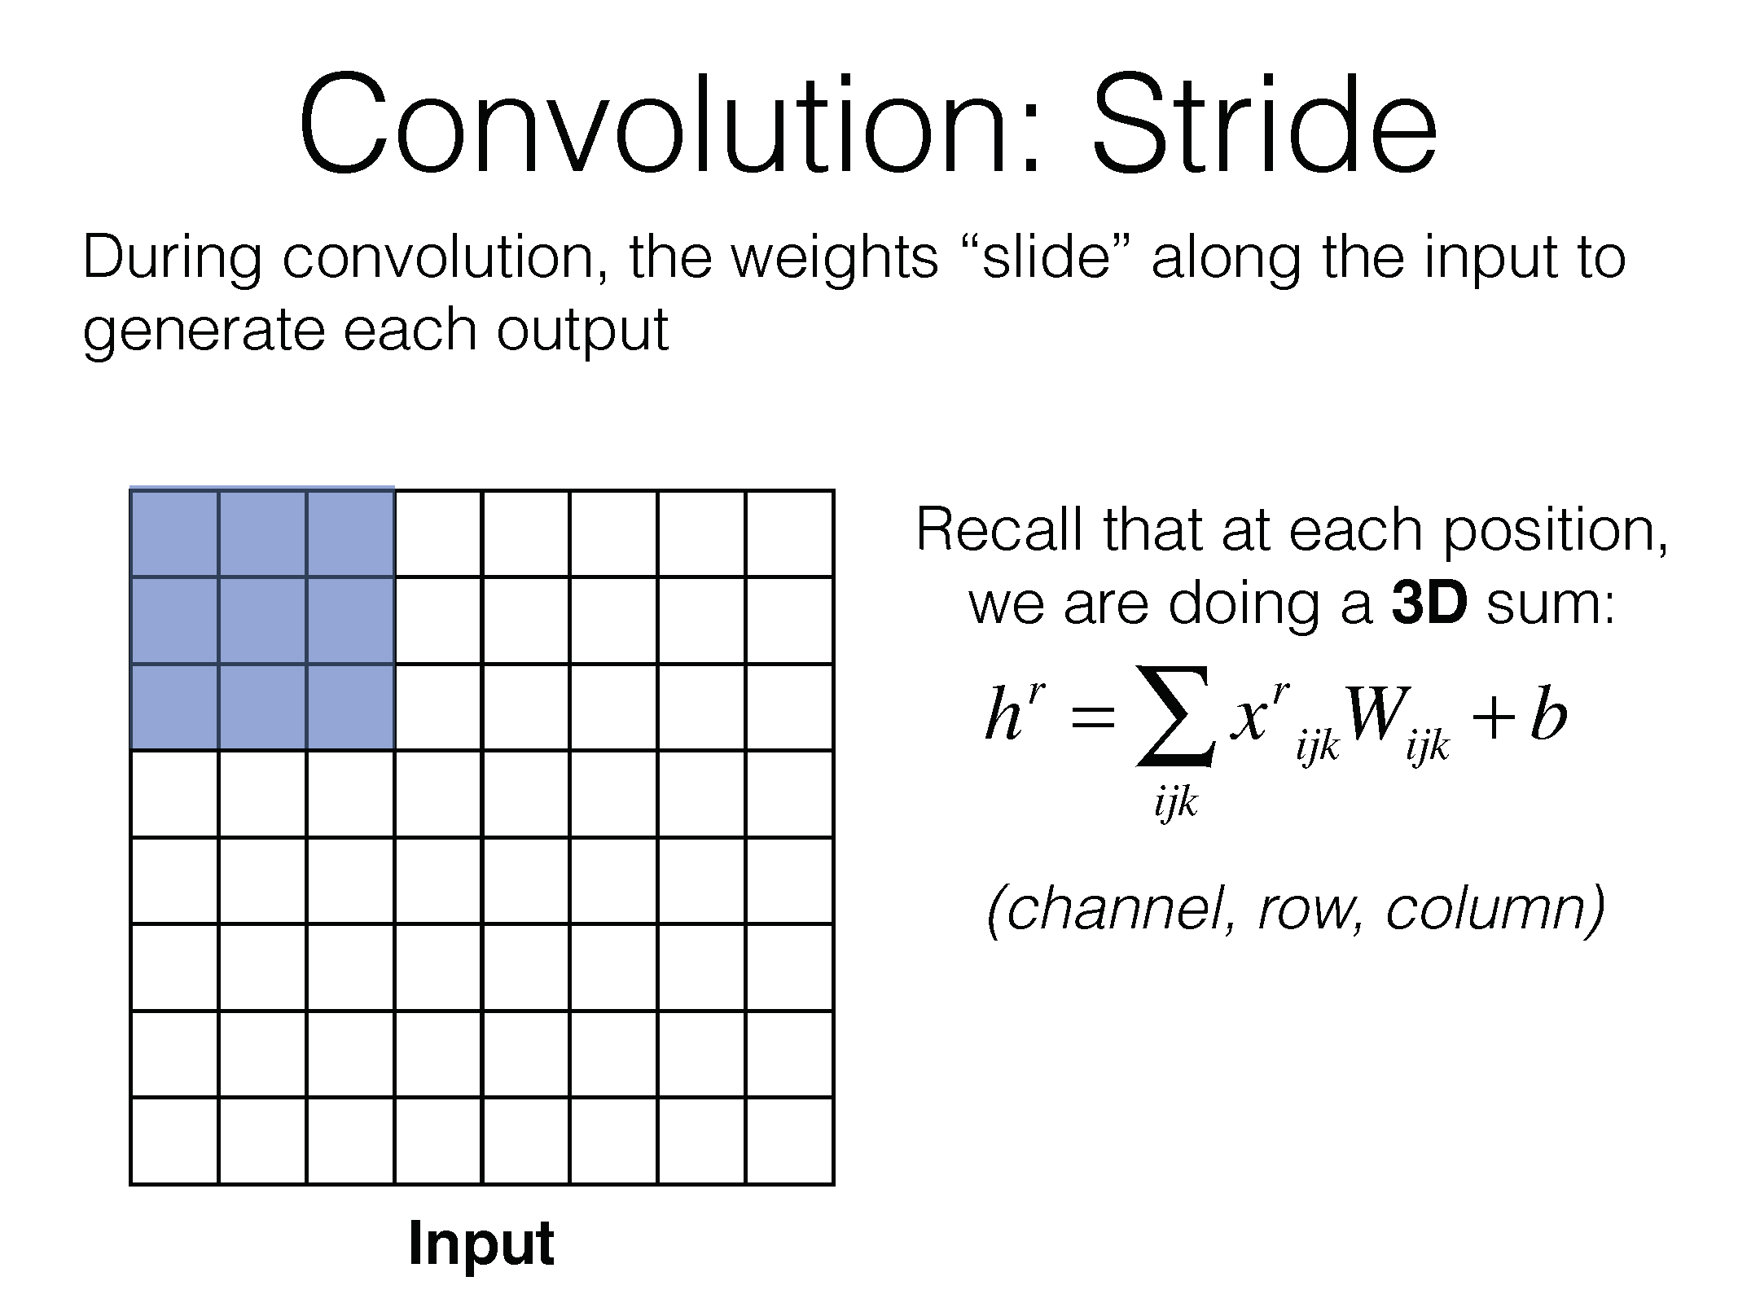

Slide 59
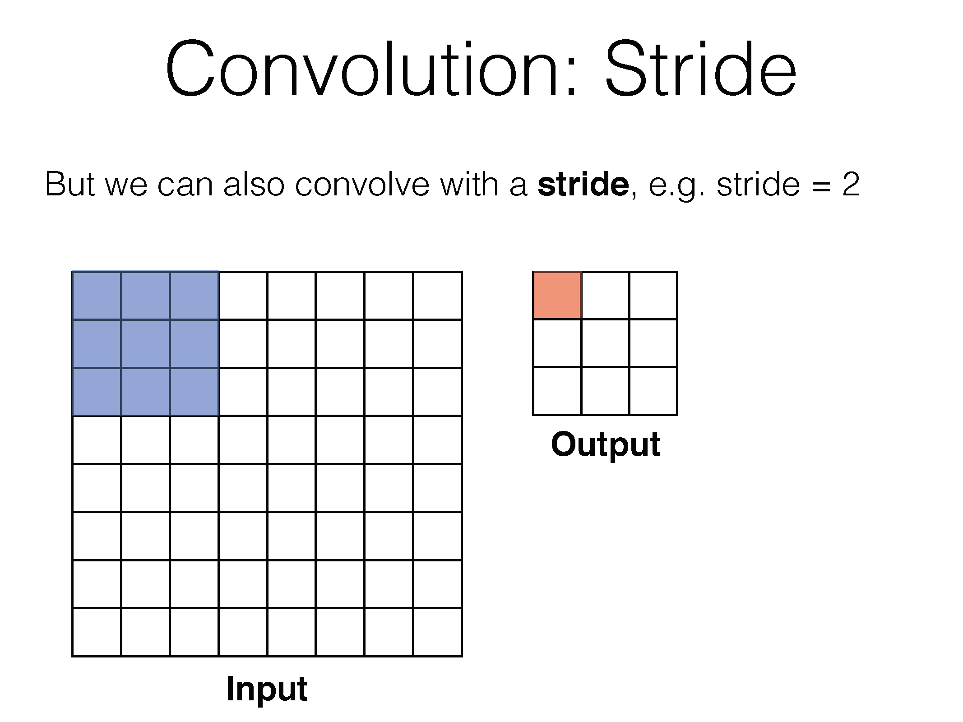

Slide 60
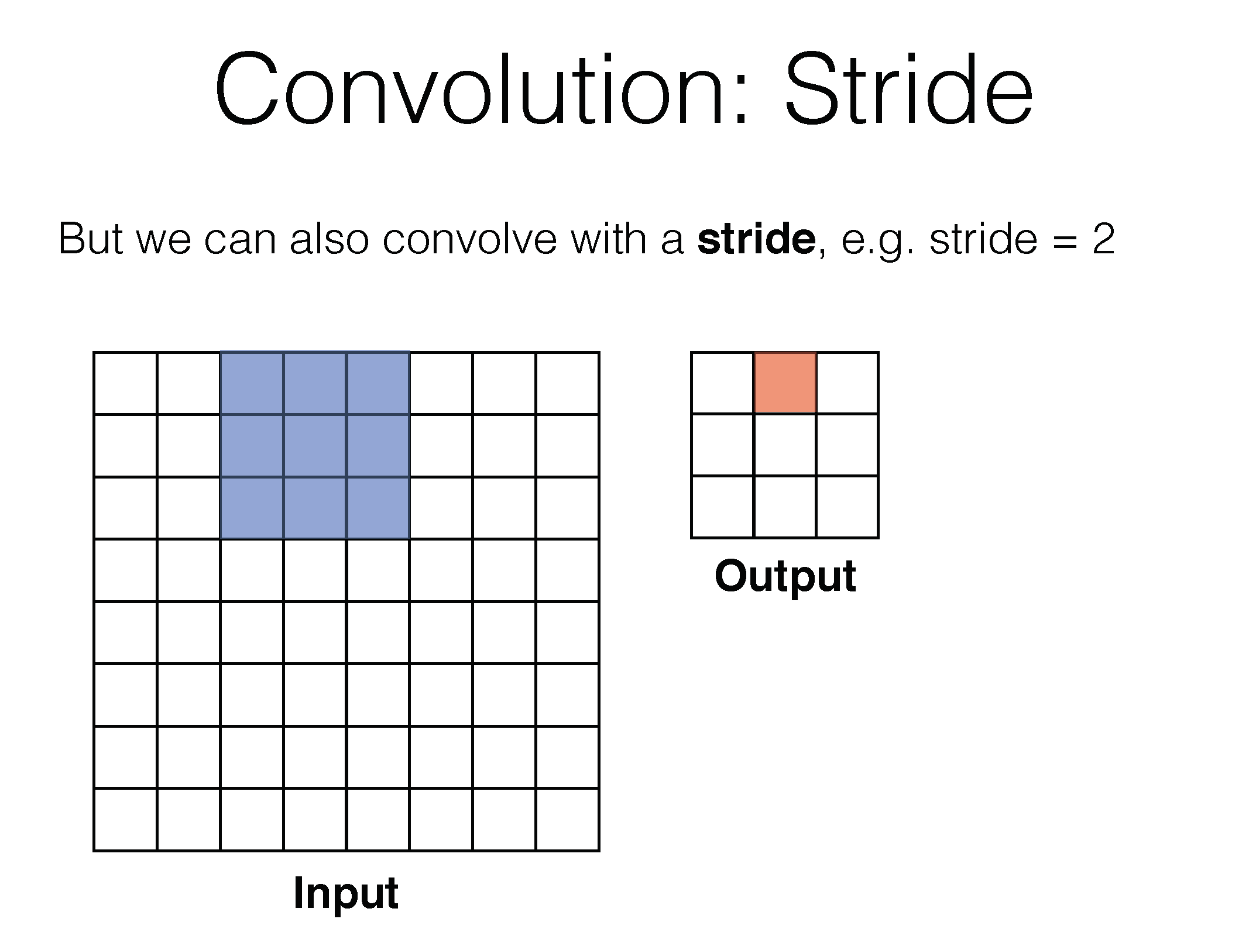

Slide 61
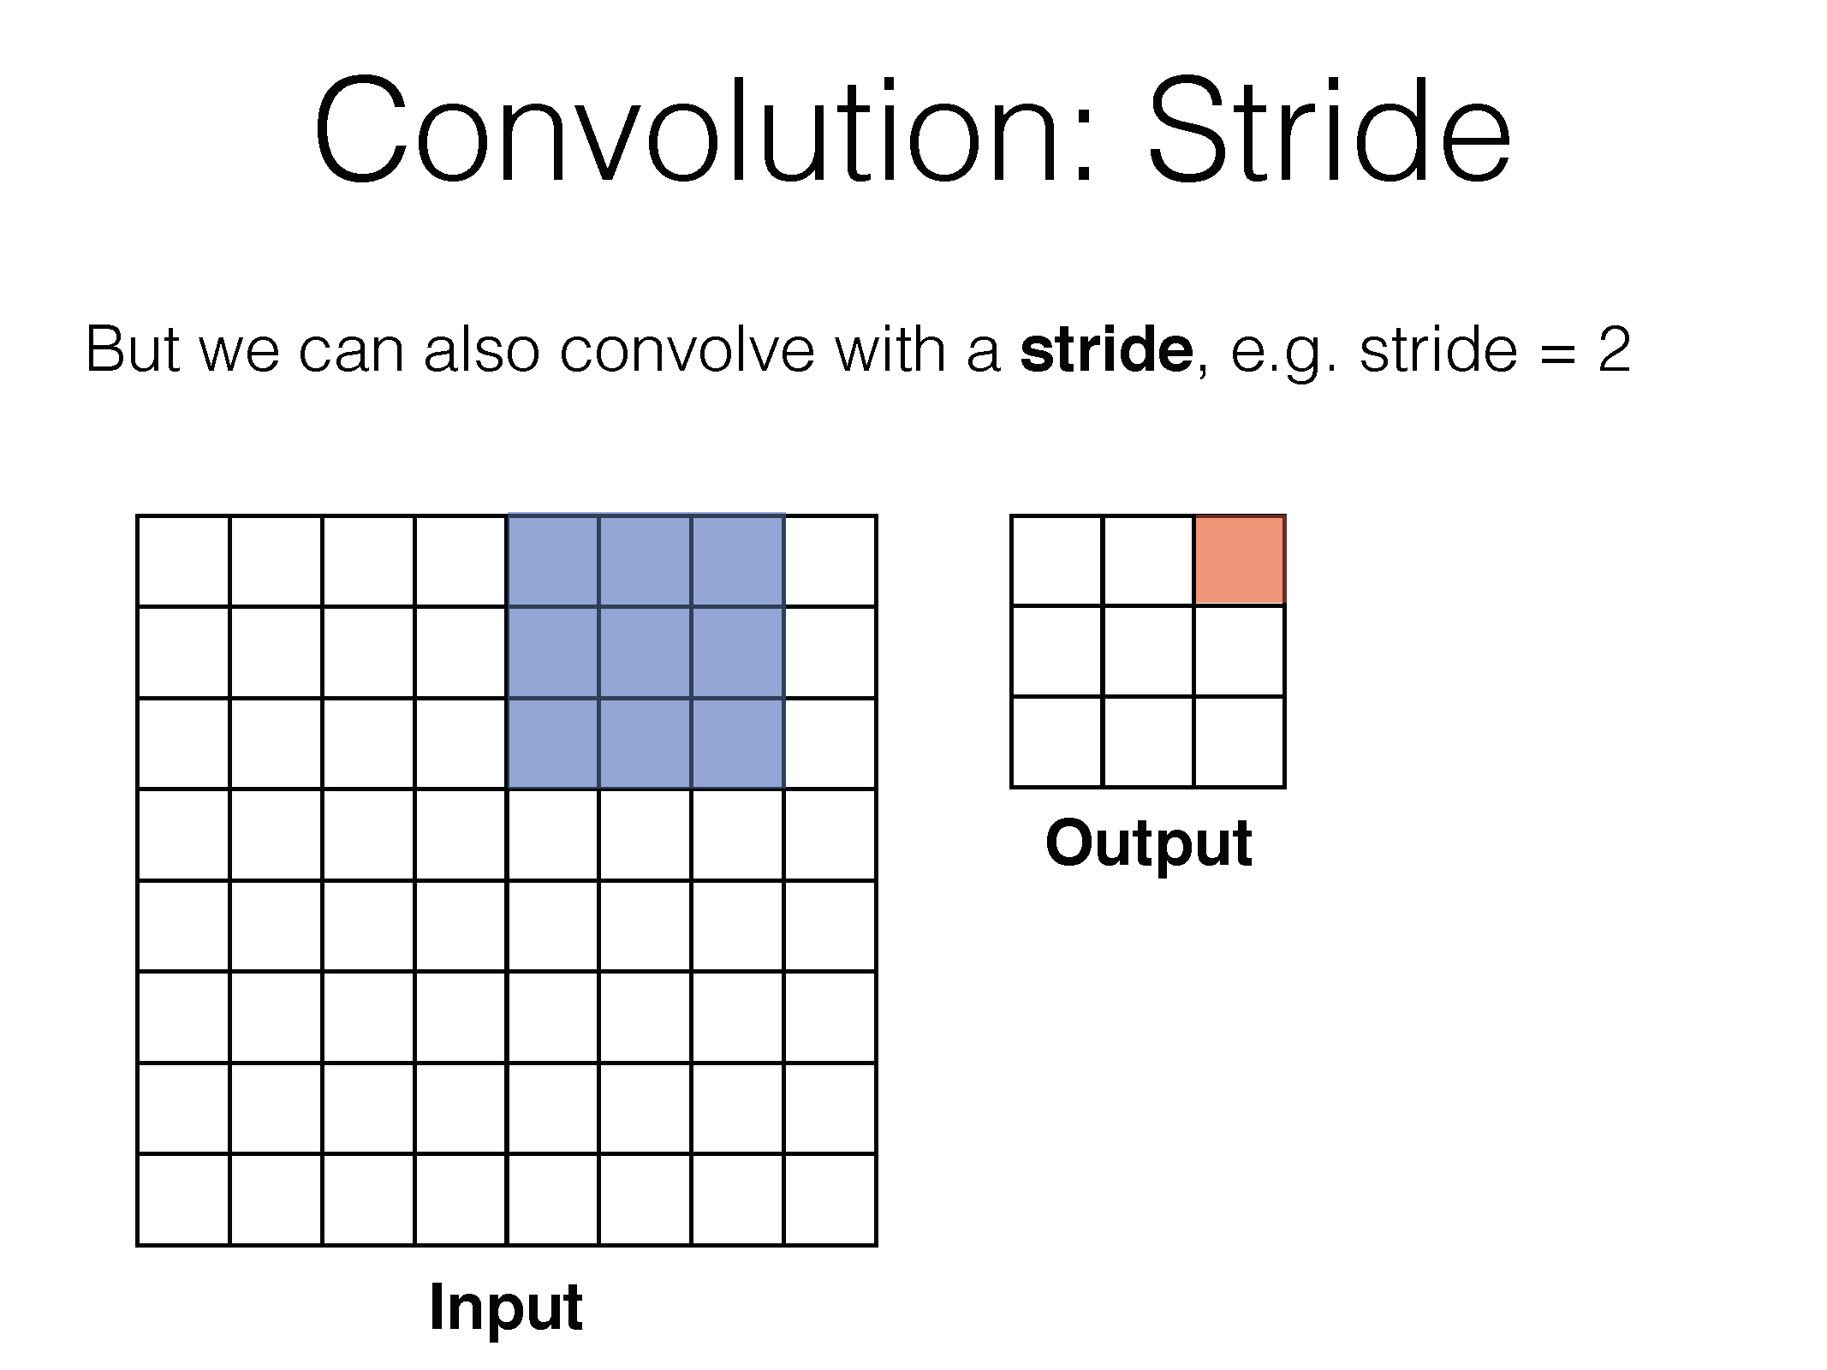

Slide 62
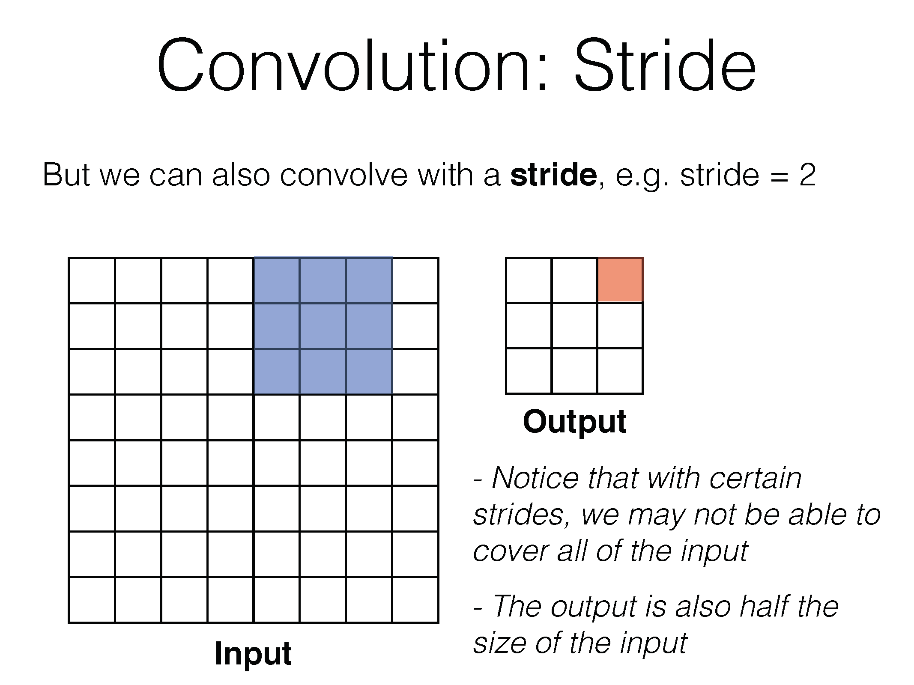

Slide 63


Slide 64


Slide 65


Slide 66


Slide 67


We can choose different parameters for the convolution:
$$w_{out}=\frac{w_{in}+2p−k}{s}+1$$
Such that $w_{out}$ is an int.

Slide 68


Slide 69


Slide 70


Slide 71


Slide 72
Visualization example
https://www.youtube.com/watch?v=AgkfIQ4IGaM

